Slide 1




Slide 2
Agenda
Project Overview
Narrative Team
Level Design
Design Team
Audio Team
Development Team
Playtesting
Blank Slate, Journey of Unknown & Unbound

Slide 3
23-24 Production Course
Project Leads
Zoe Delap
Bridget Kurr
Brennan Crowder
Chris Burris
Akram Taghavi-Burris
Development Teams
Brennan Crowder
Jeremiah Underwood
Coleton Wheeler
Ben Krieger
William Gulick
Jacob Sharp
Haley Kelly
Zoe Delap
Design Team
Bridget Kurr
Haley Kelly
Ava Fritts
Andrew Mires
Zoe Delap
Audio Team
Joshua Lowery
Haiying Zeng
Annette Lau
Blaine Grimes
Blank Slate, Journey of Unknown & Unbound

Slide 4
Project Overview - Premise
Player awakens in a whimsical valley and stumbles upon a village
They discover their ability to magically gain traits of the species in the world
Player gets to know the creatures of this universe and seeks to understand how they came to be
Use the teleporter to leave the valley, and then discover the wizards tower
Solve puzzles using abilities to remove the harmful fog from the tower
Blank Slate, Journey of Unknown & Unbound

Slide 5
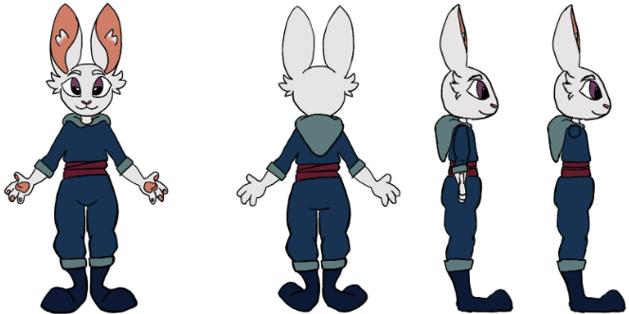
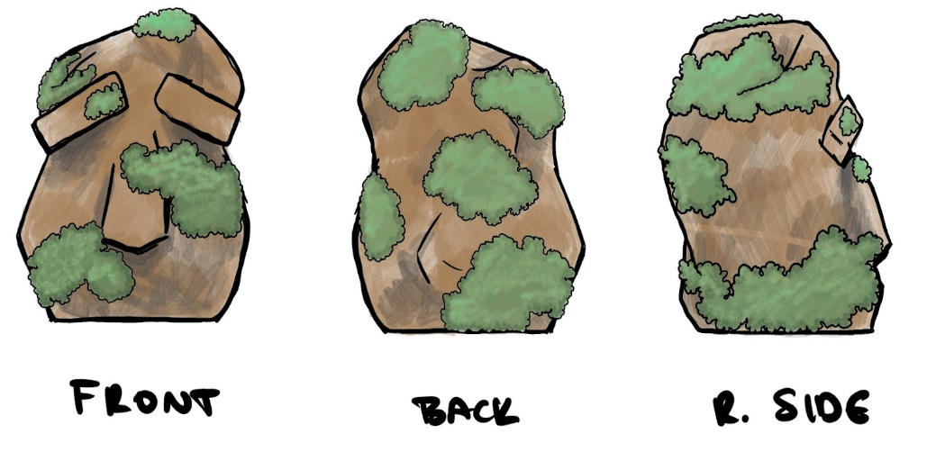
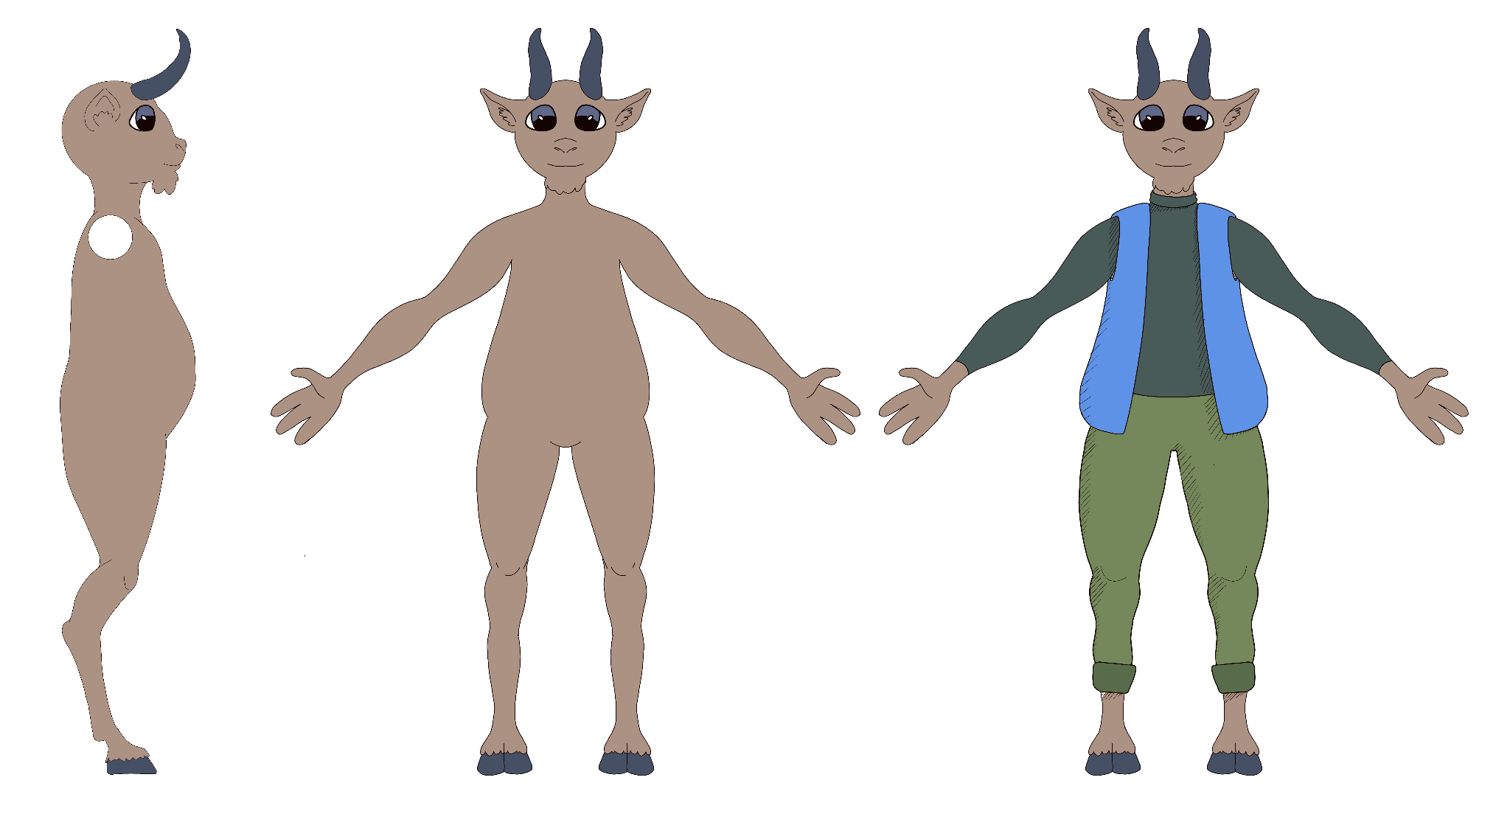
Project Overview - Species
Rabbits
Appear in first level
Give player jump ability
Stoneskin
Appear in first level
Give player stoneskin ability
Goats
Will appear in final level
Give player ram ability
Blank Slate, Journey of Unknown & Unbound

Slide 6
Narrative Team
Rabbit folk, quests galore, magical ruins

Slide 7
Narrative Overview
Not initially a focus
Story has had several iterations
Goal this sprint was putting it all together
Created two communities, rocks and rabbits
Additional goat community scrapped due to time
Final wizard tower narrative well underway
Ben Krieger

Slide 8
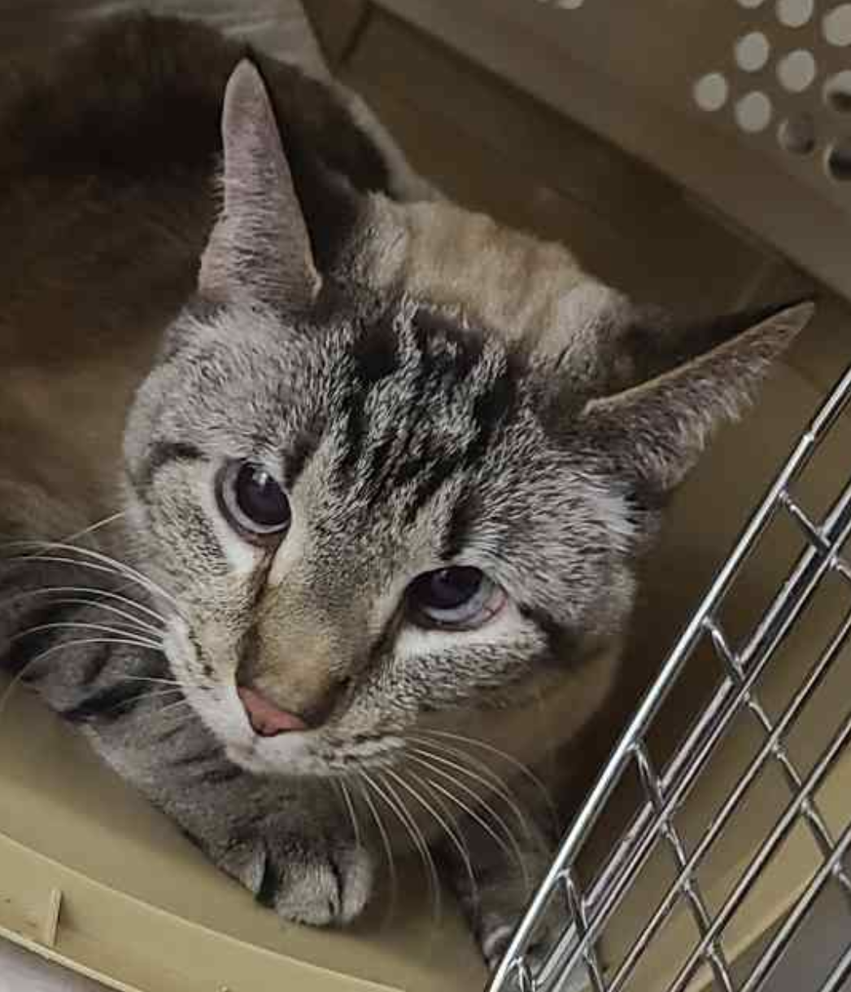
Quest Scripting
Wrote quest concept outline
Wanted an overall theme/goal for each area
Main quests vs side quests
Created ideas for reusable NPCs with personality
Got a new cat, Krieger & Zoe say shes our team mascot now
Haley Kelly

Slide 9
Quest Scripting
Spearheaded narrative development in early stages
Led development of the broader plot and world lore
Directed NPC dialogue and wrote dialogue scripts
Developed story quests for the in-game areas and characters
William Gulick

Slide 10
Level Design
Orchards, crop fields, valleys, teleporters

Slide 11
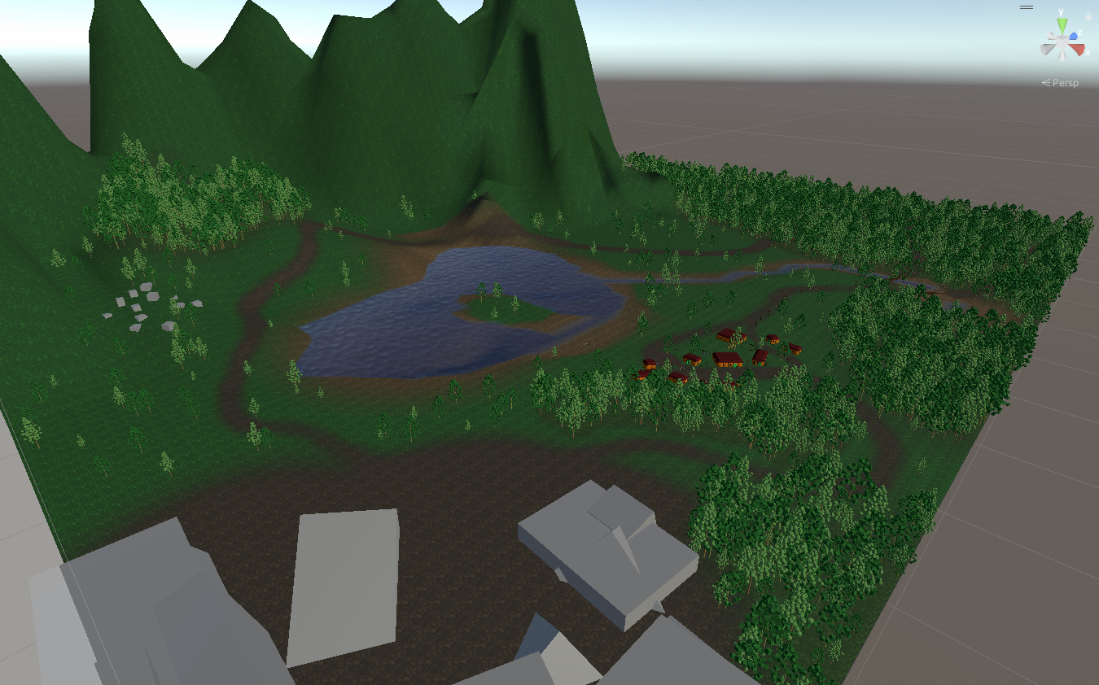
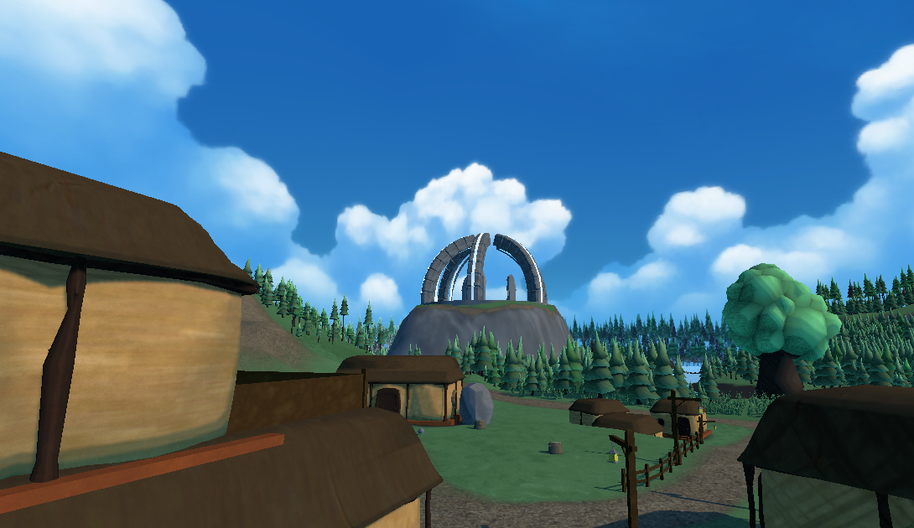
Level Design Overview
The entire level was recreated from scratch, using a new terrain layout, texture, and flora along with an overhauled shader.
Andrew Mires

Slide 12
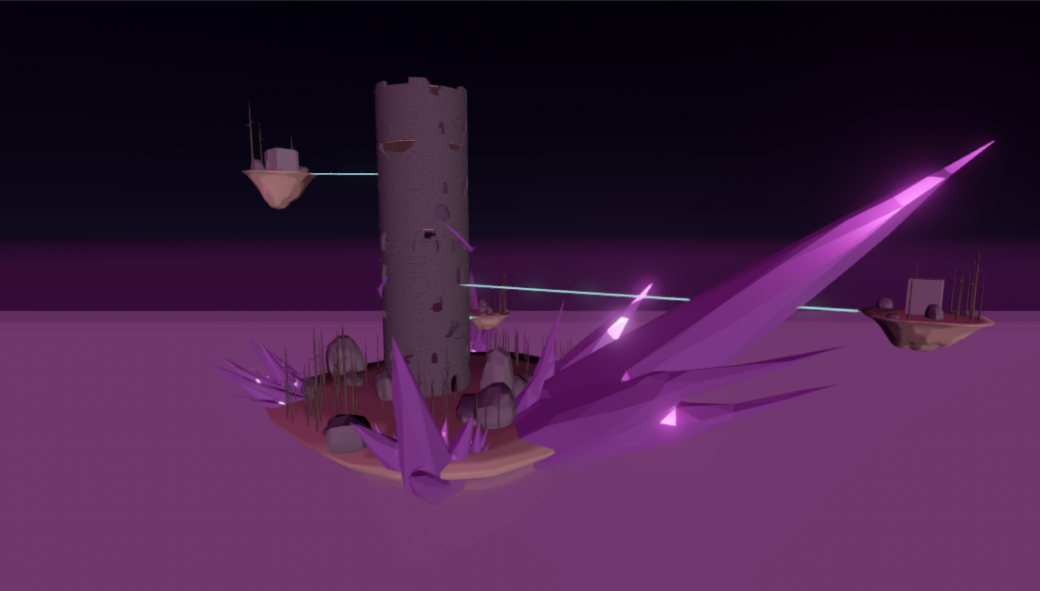
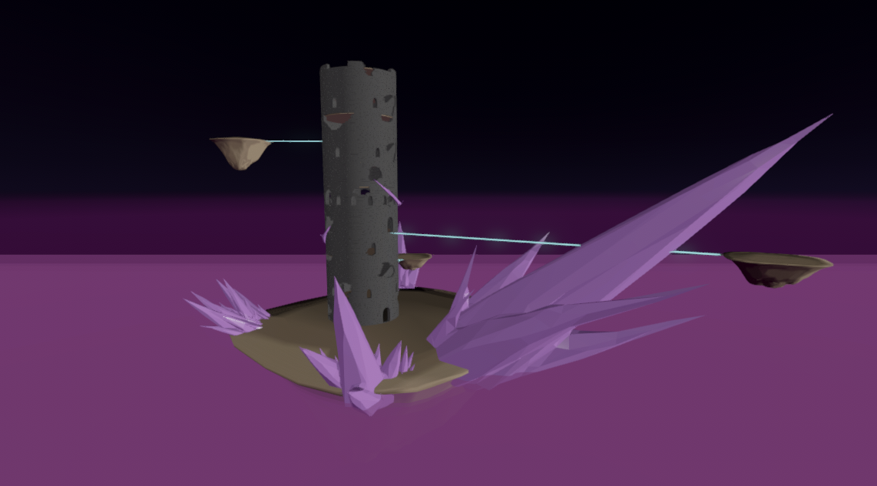
Level Design Overview
Andrew Mires

Slide 13
Design Team
Rabbits, rocks, whimsical environment models

Slide 14
Design Overview
Create concept art
Develop characters and environment
Focus on visual design
Make models and animations
Pivot towards lower poly models
Visually leverage the custom shader
Establish the visual identity
Optimizing textures and materials
Blank Slate, Journey of Unknown & Unbound

Slide 15
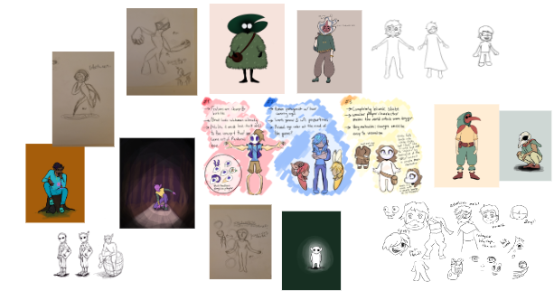
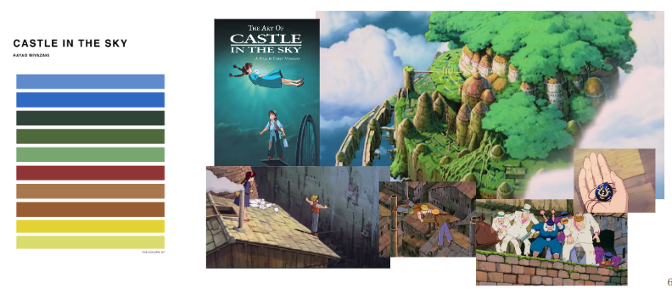
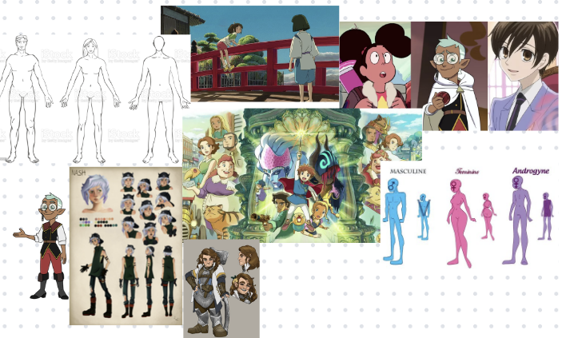
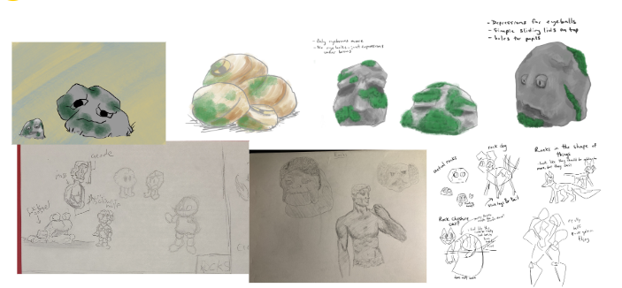
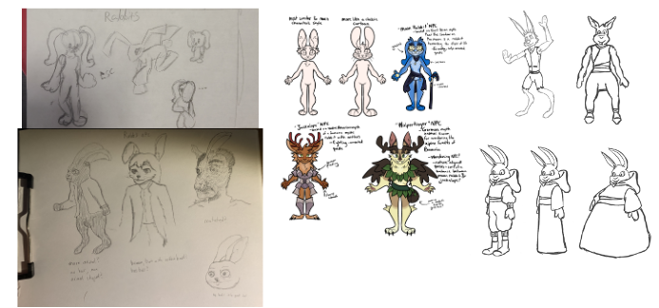
Design Overview - Concept Art and Inspiration
Bridget Kurr
Notes:
Create concept art
Develop characters and environment
3D game inspired by 2D art

Slide 16
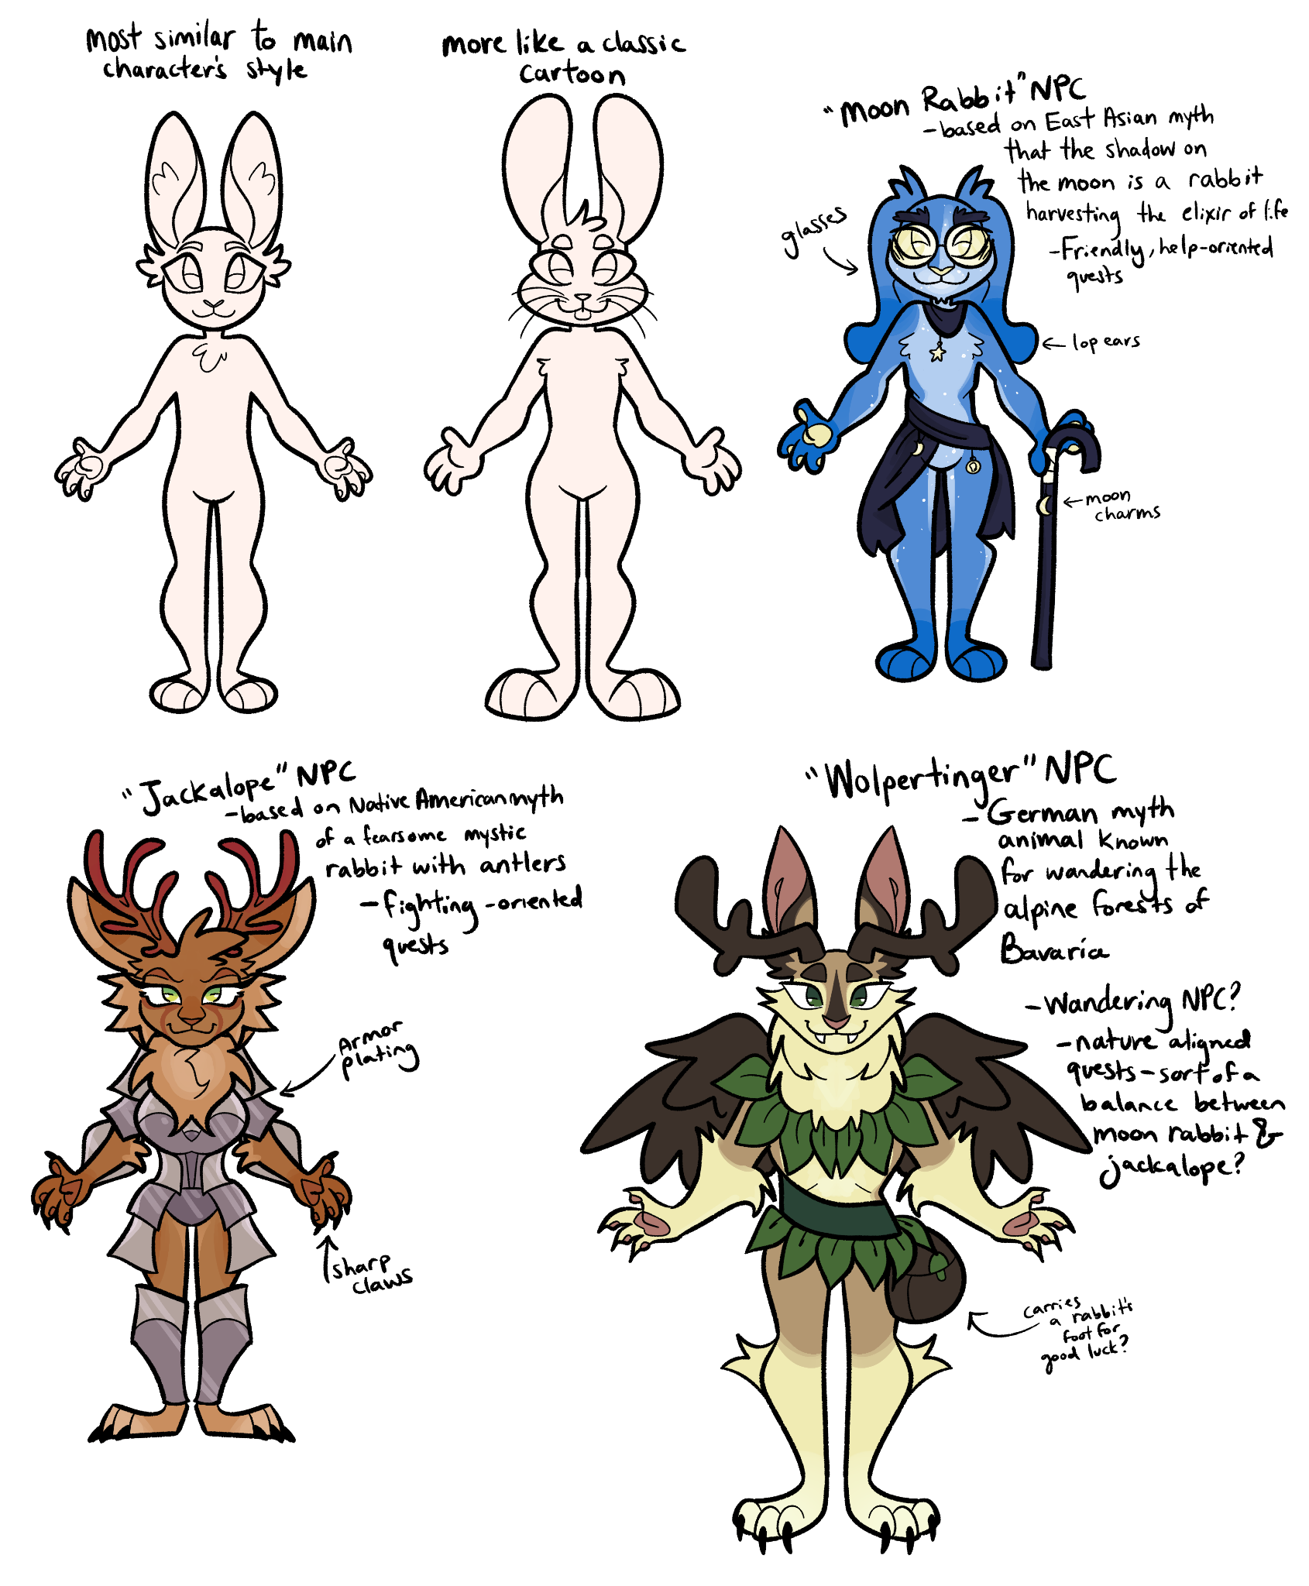
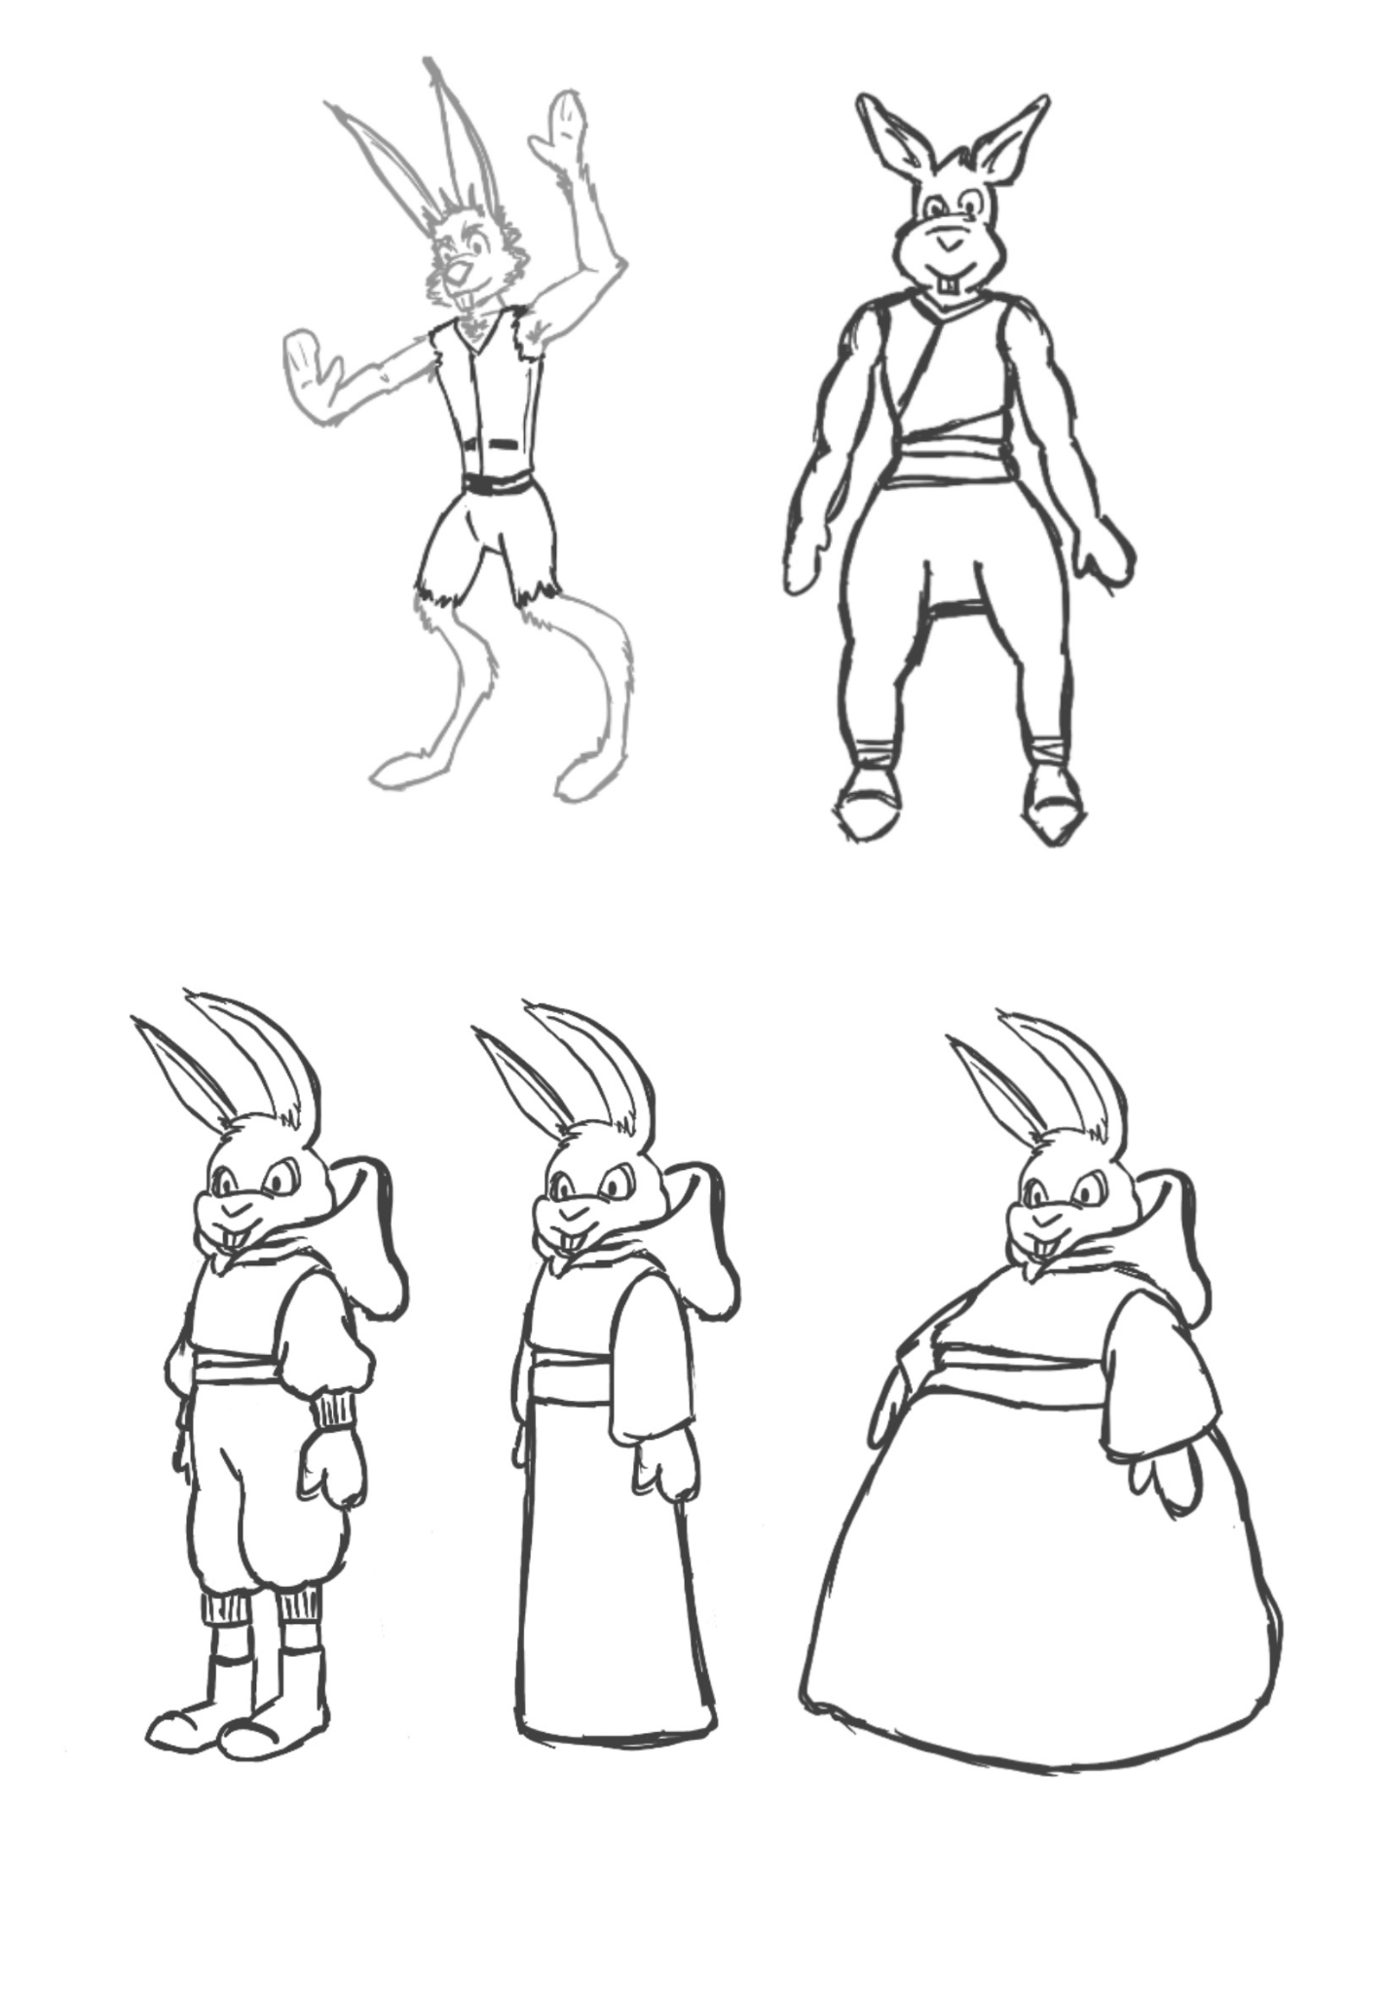
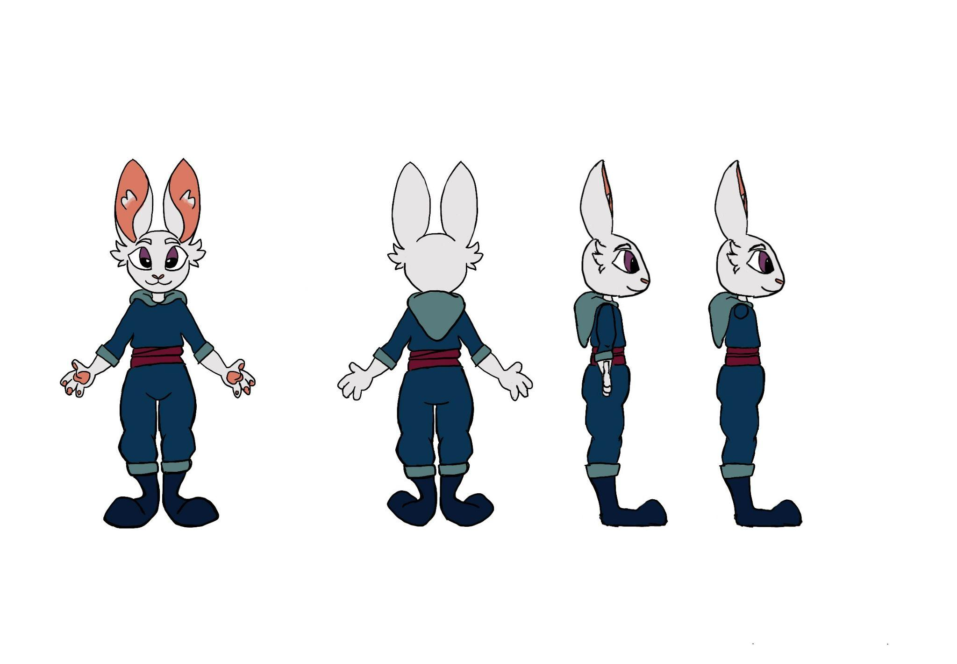
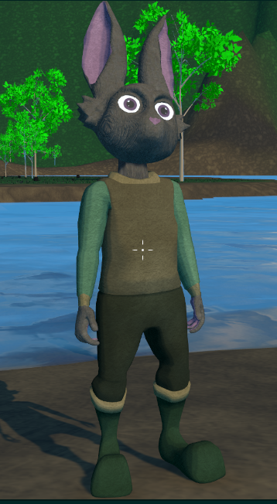
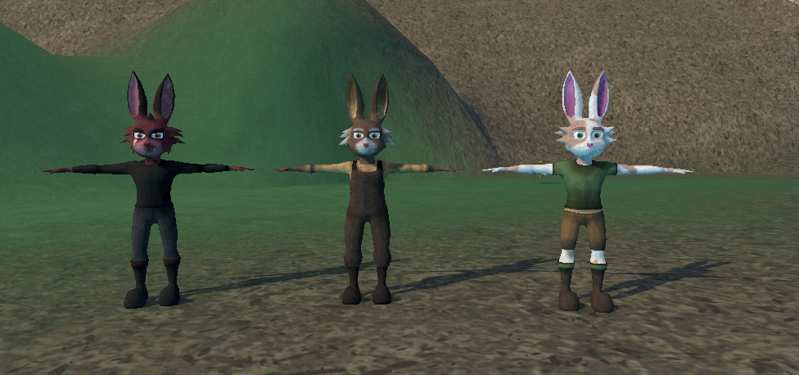
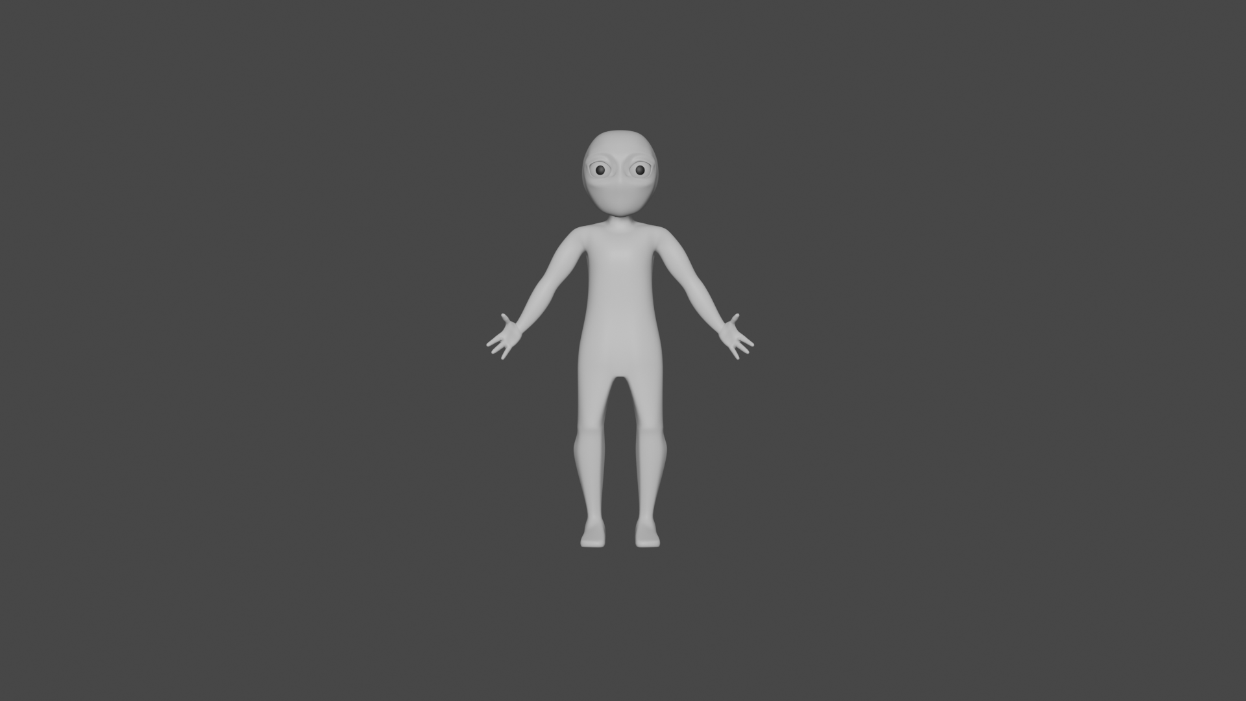
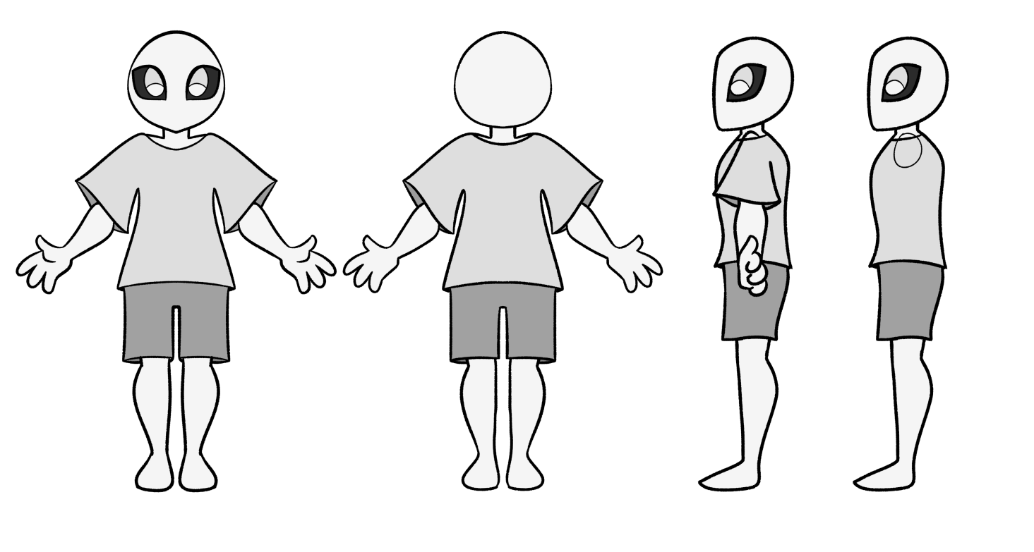
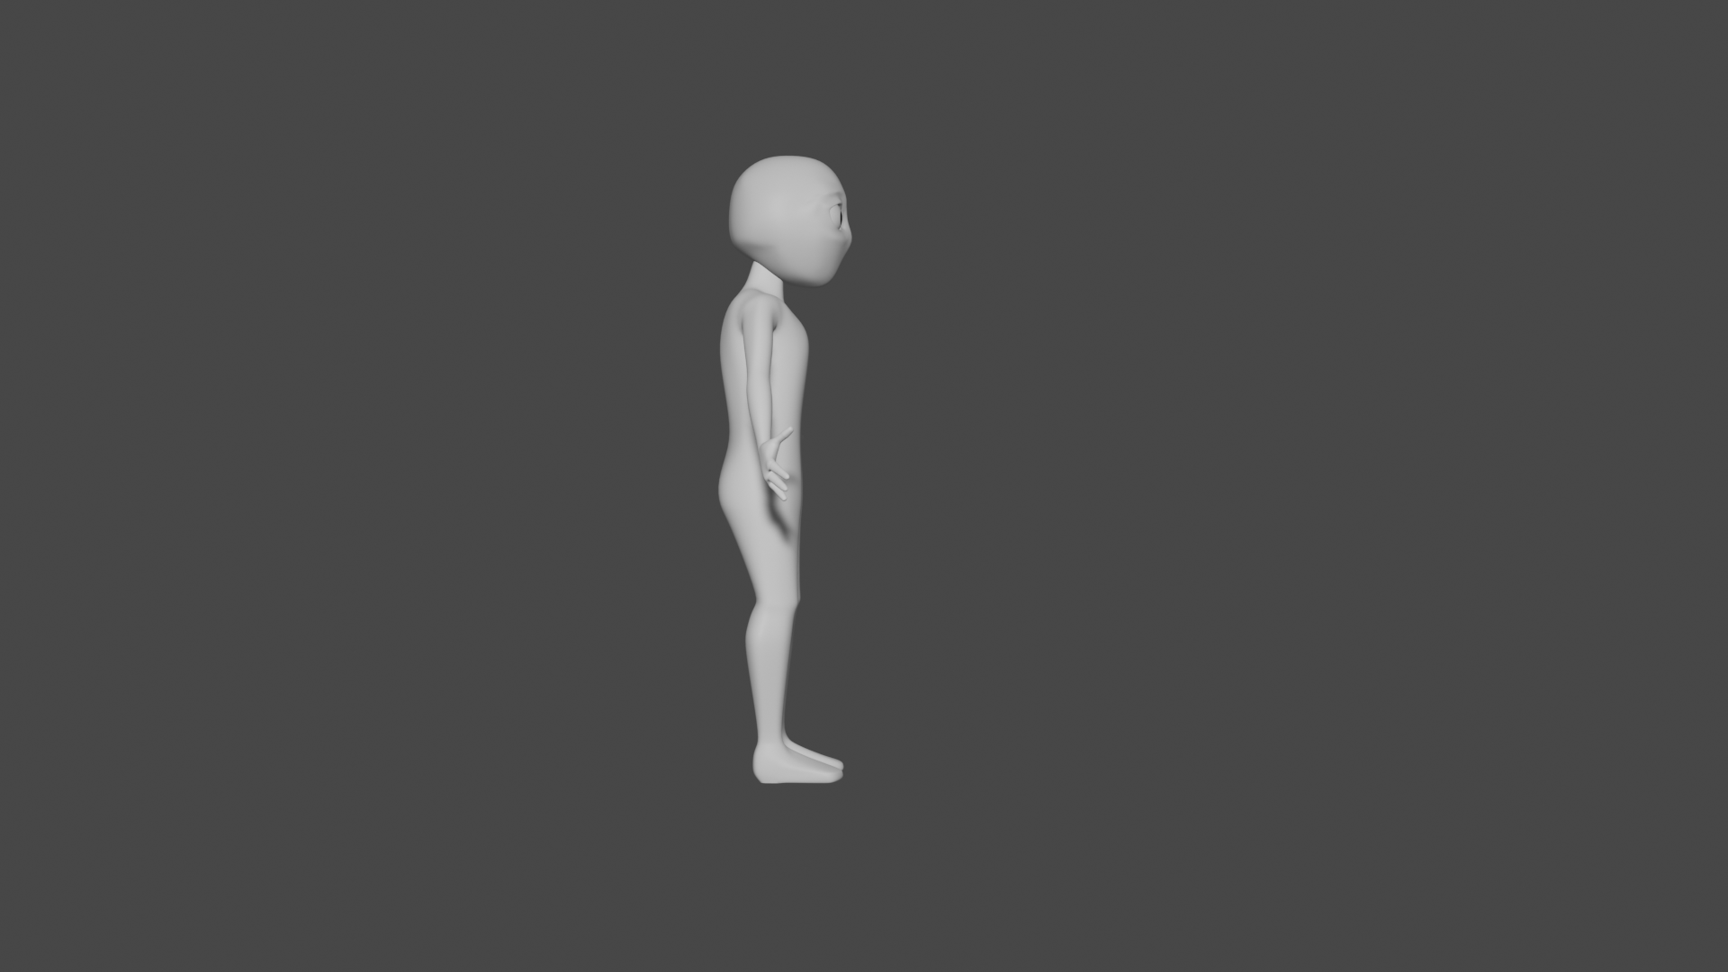
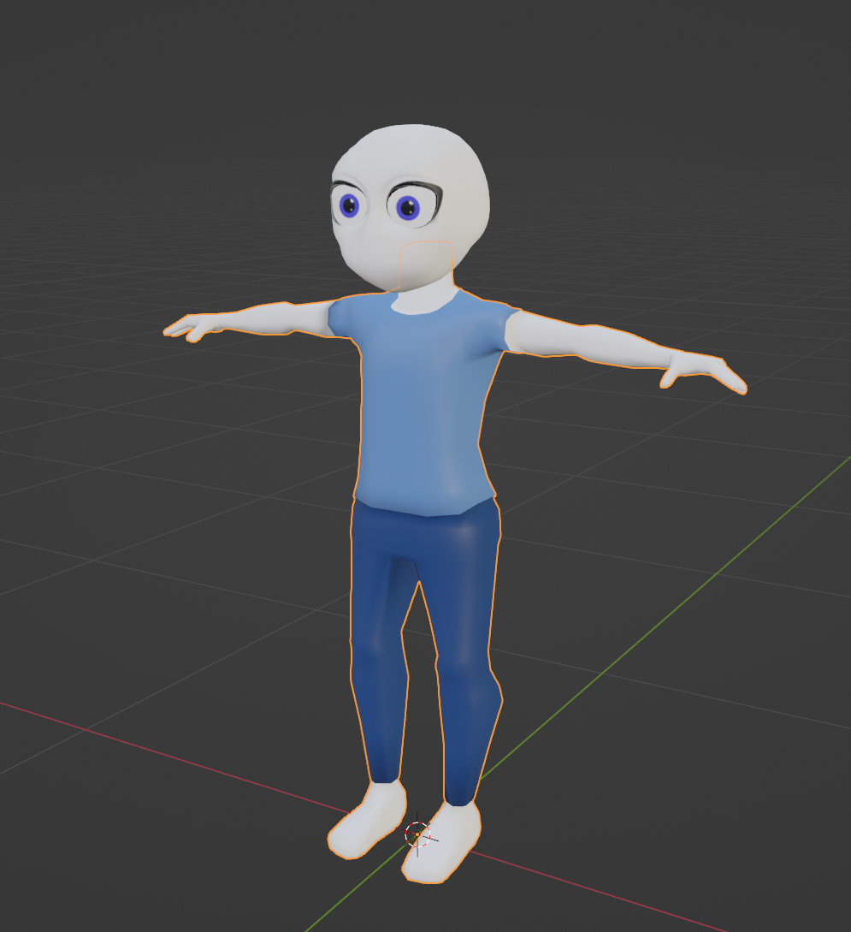
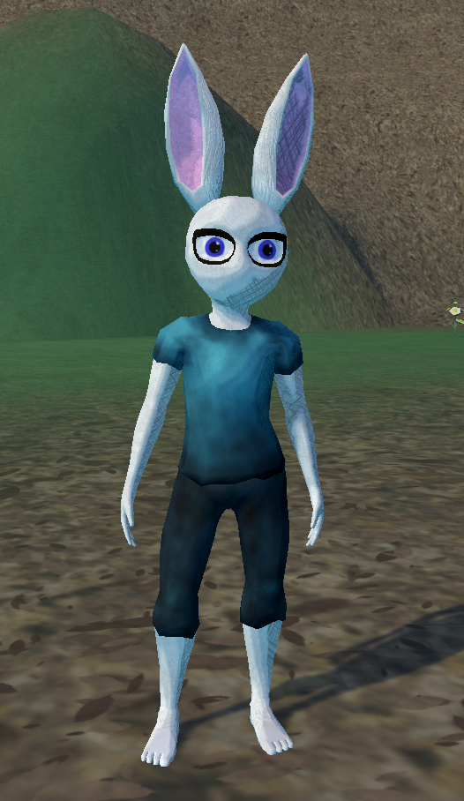
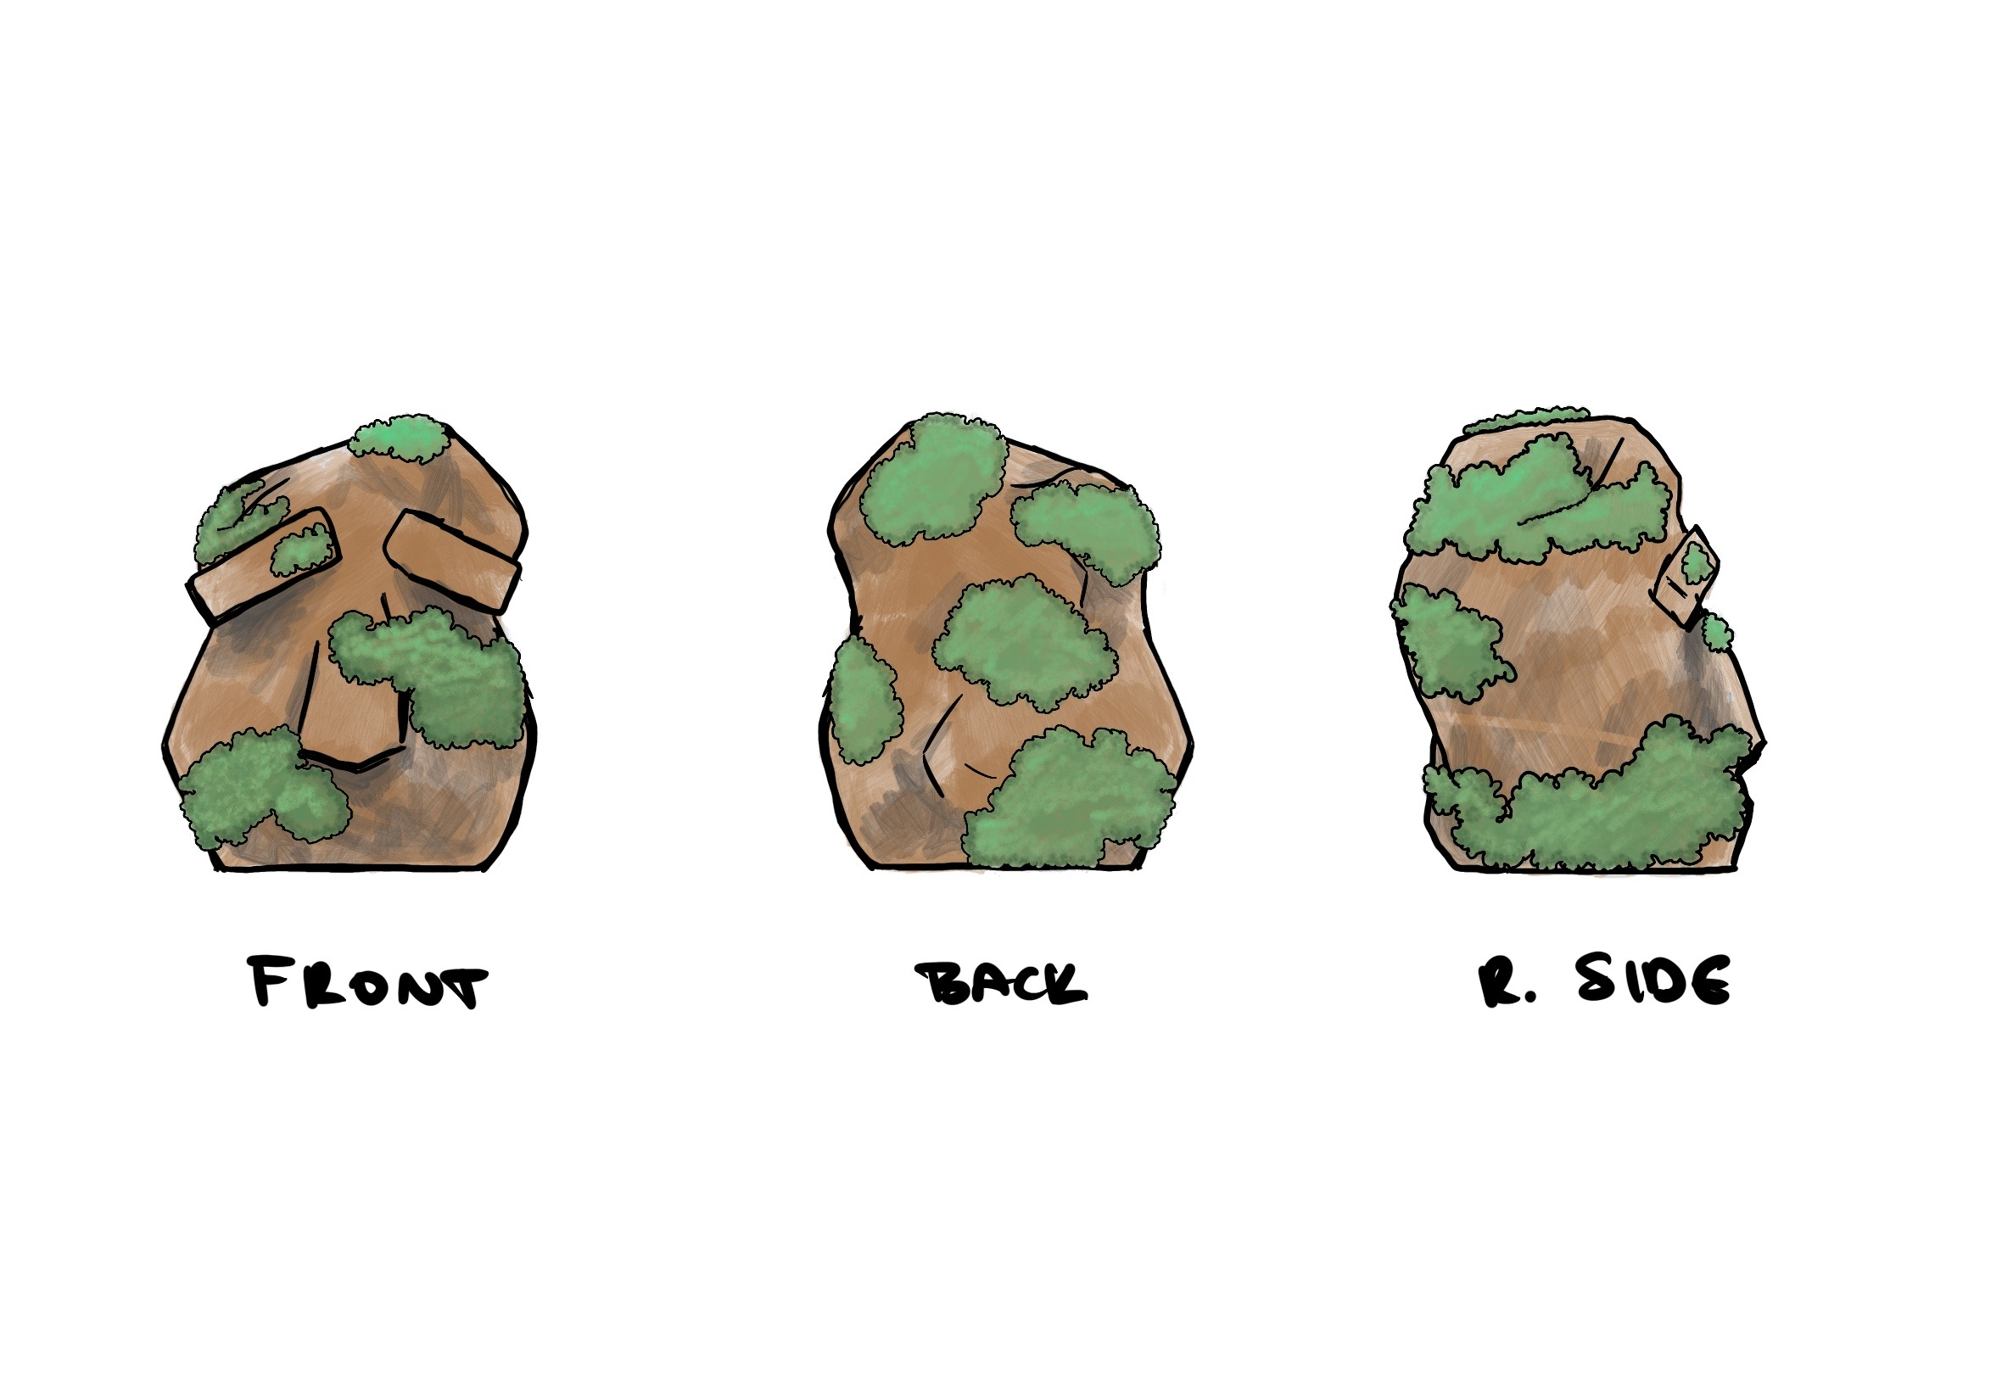
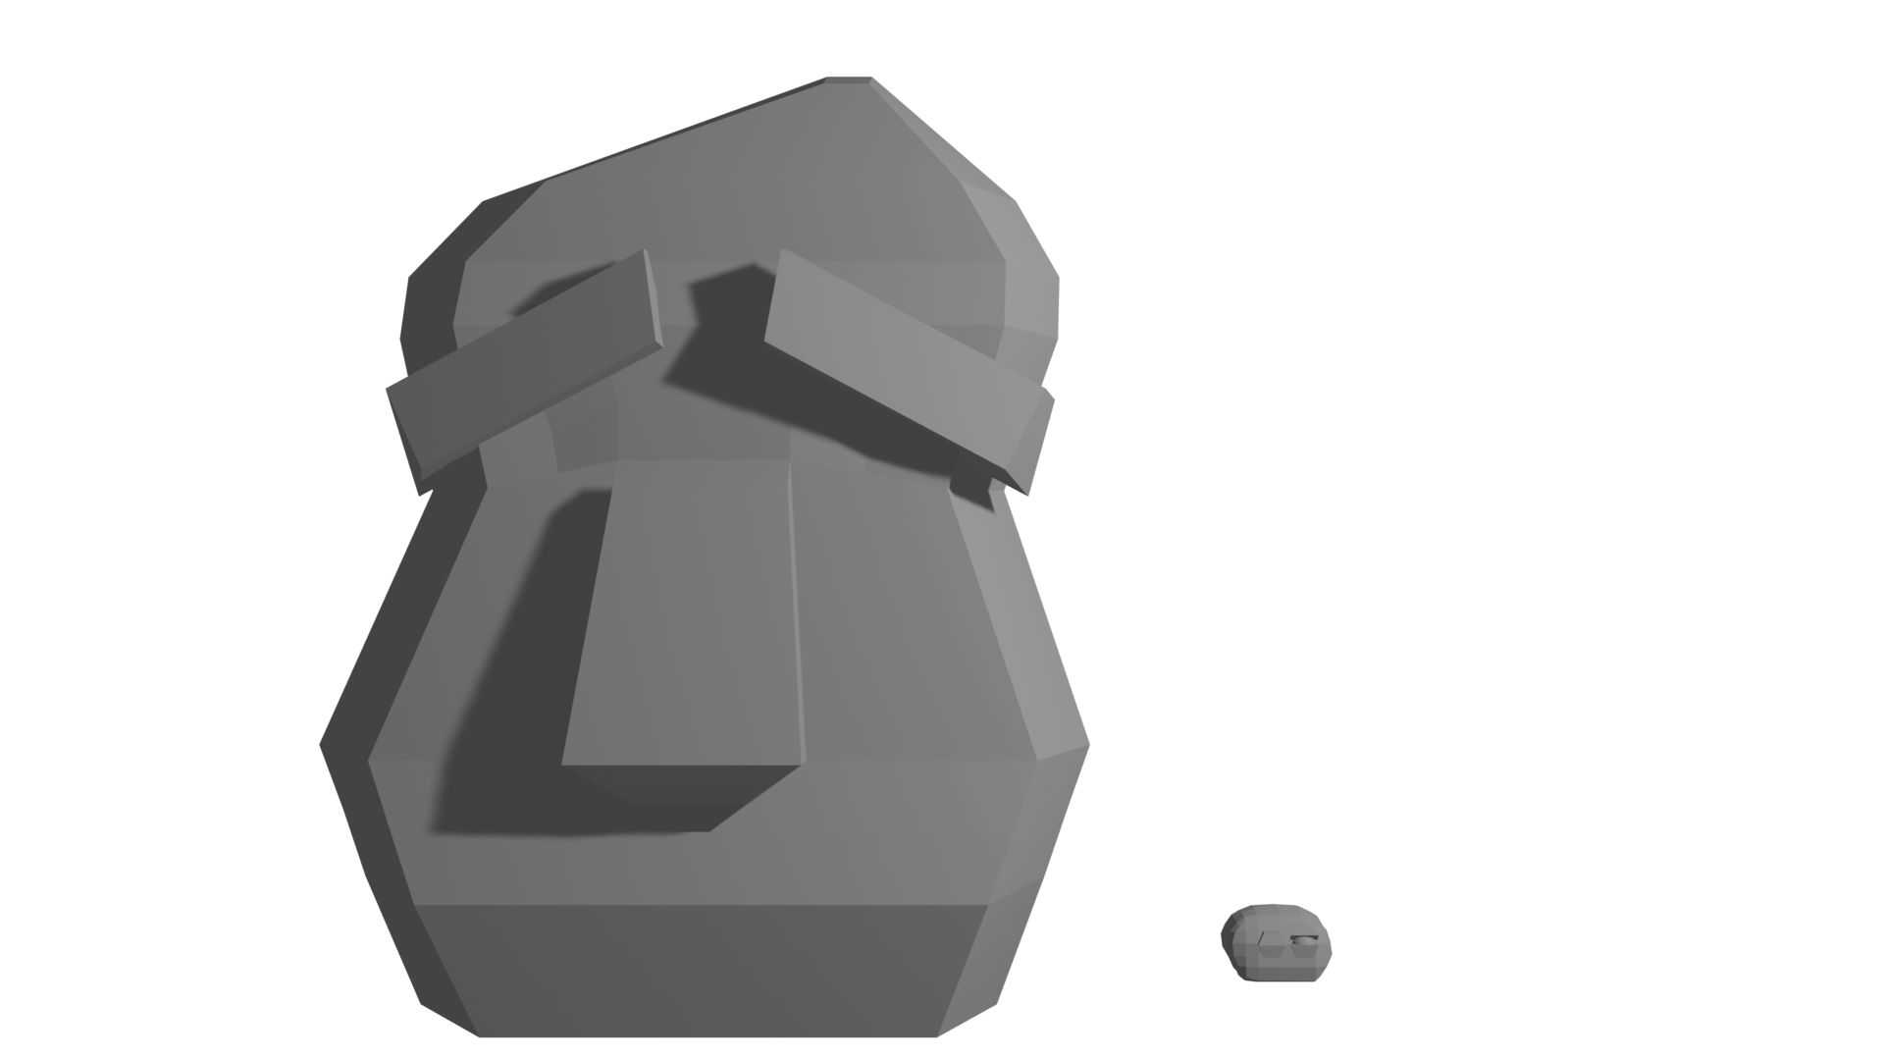
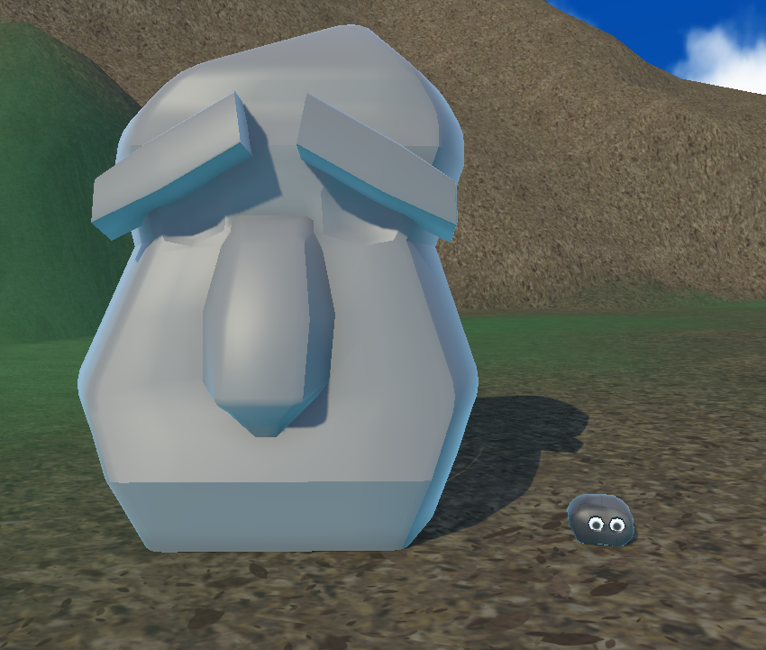
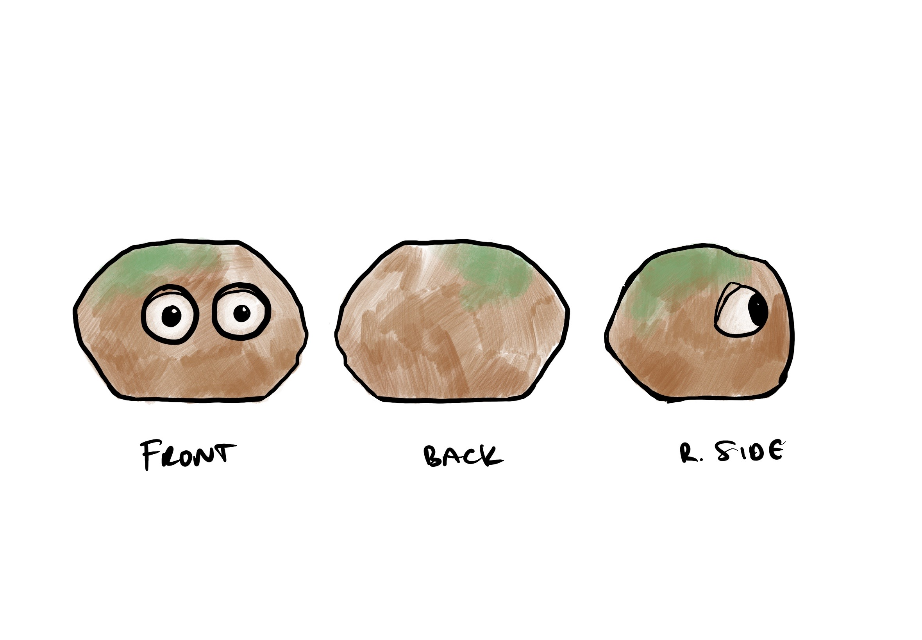

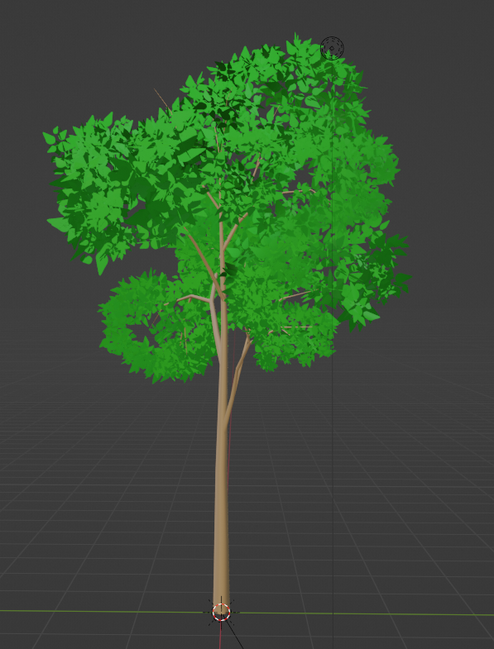
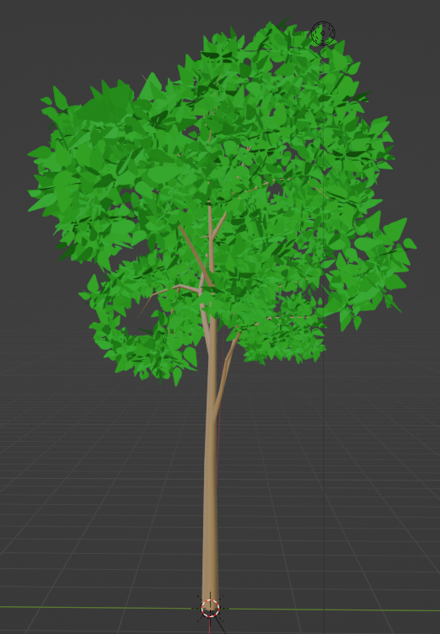
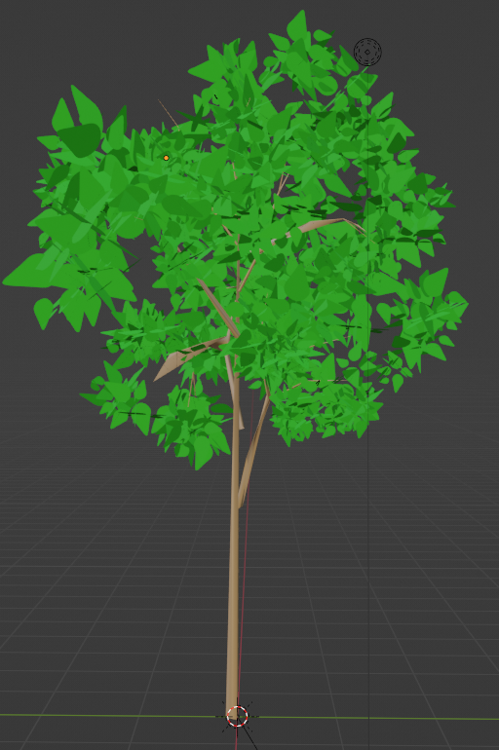
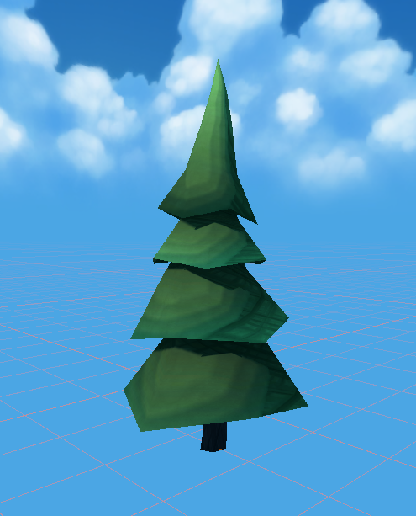
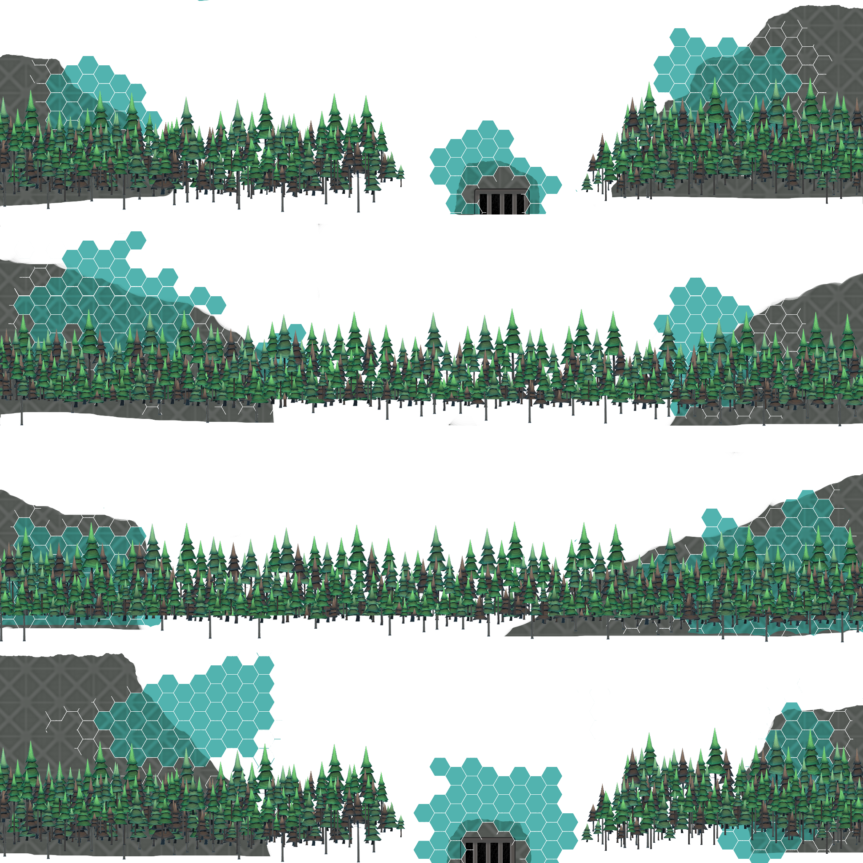

Design Overview -
Characters and Environment
Progression from exploration to committing to low poly
Utilized texture atlas to improve batching
1 8k Texture
1 Material in Unity
Flexibility in each model’s texture size
Greatly decreased batching means faster rendering speeds and no more dead laptops
Bridget Kurr

Slide 17
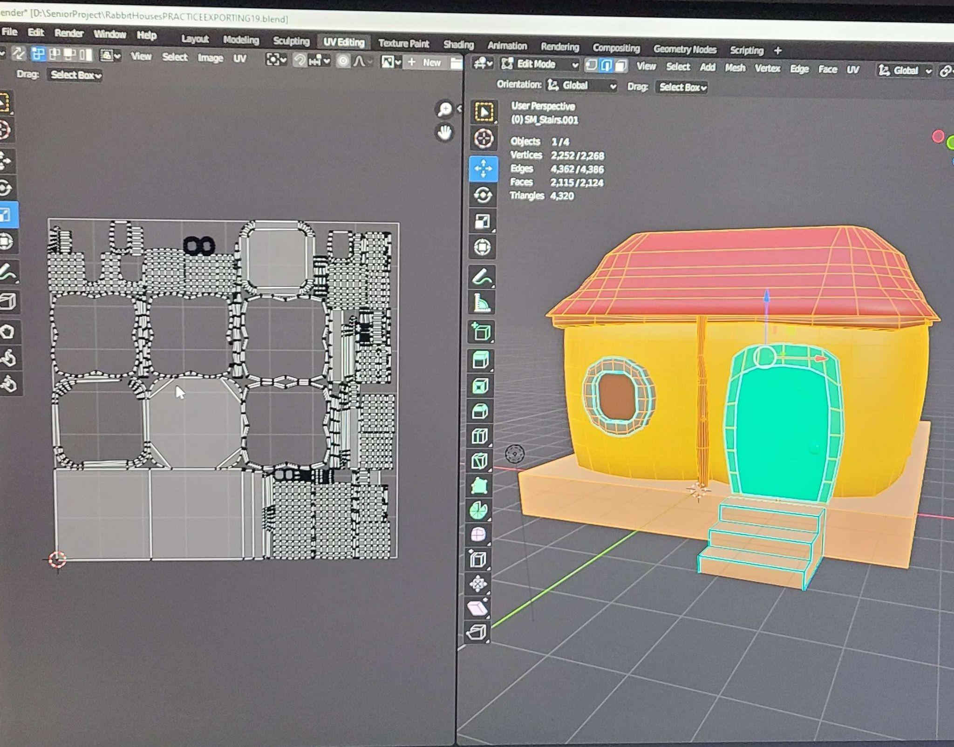
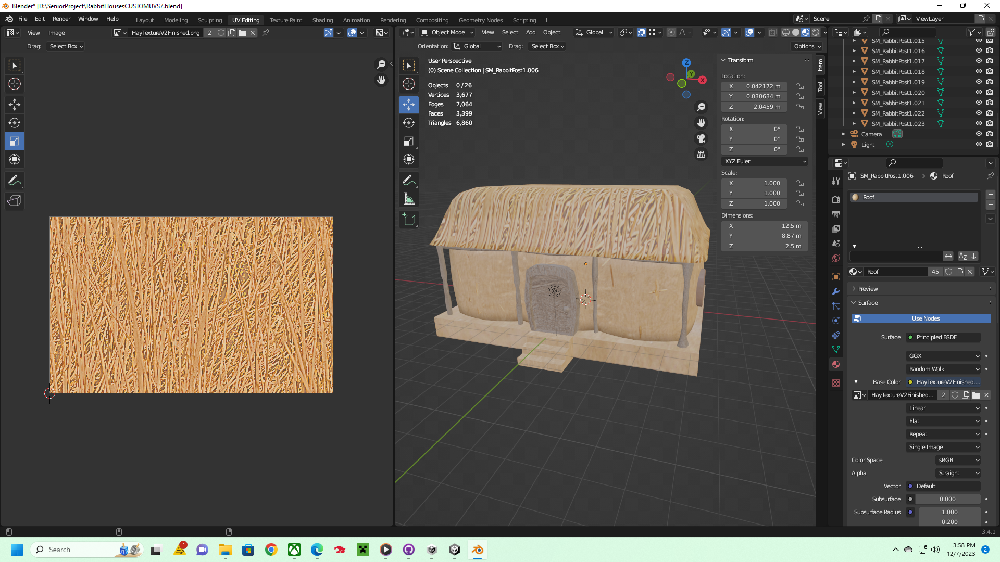
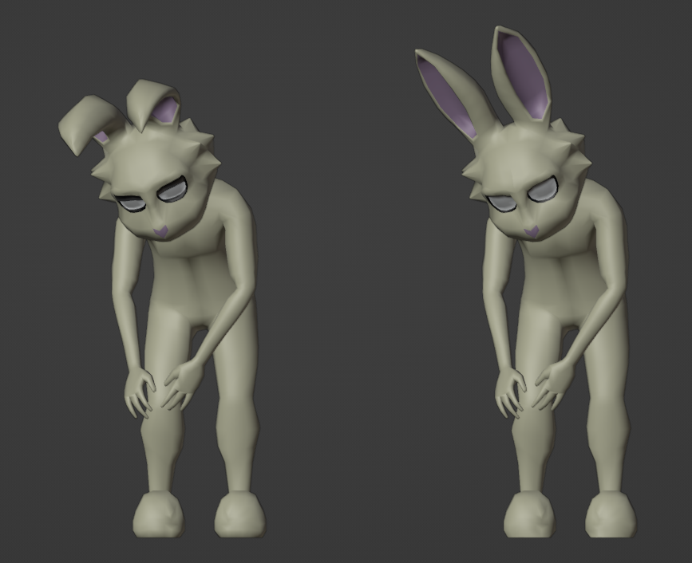
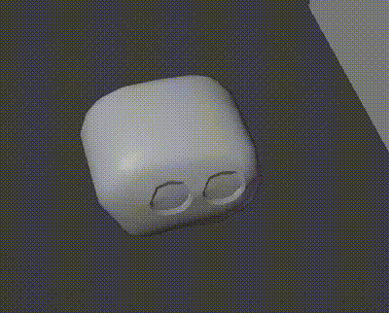
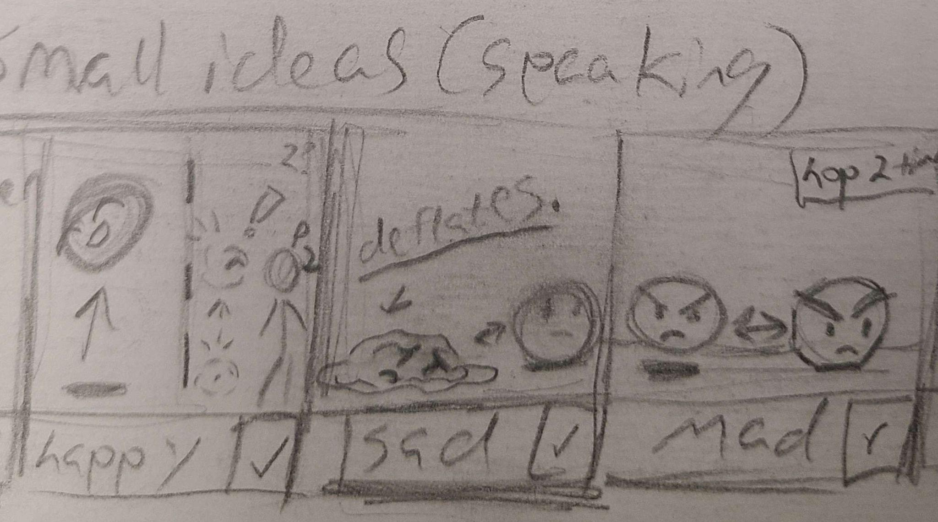
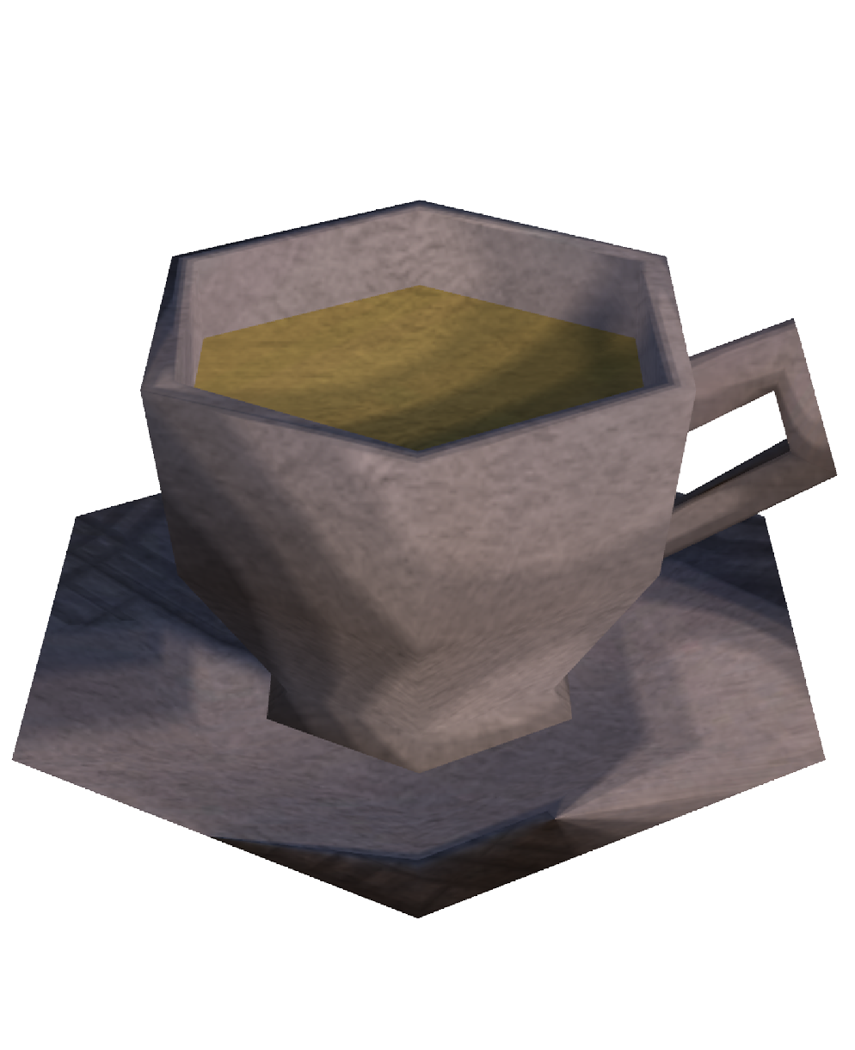
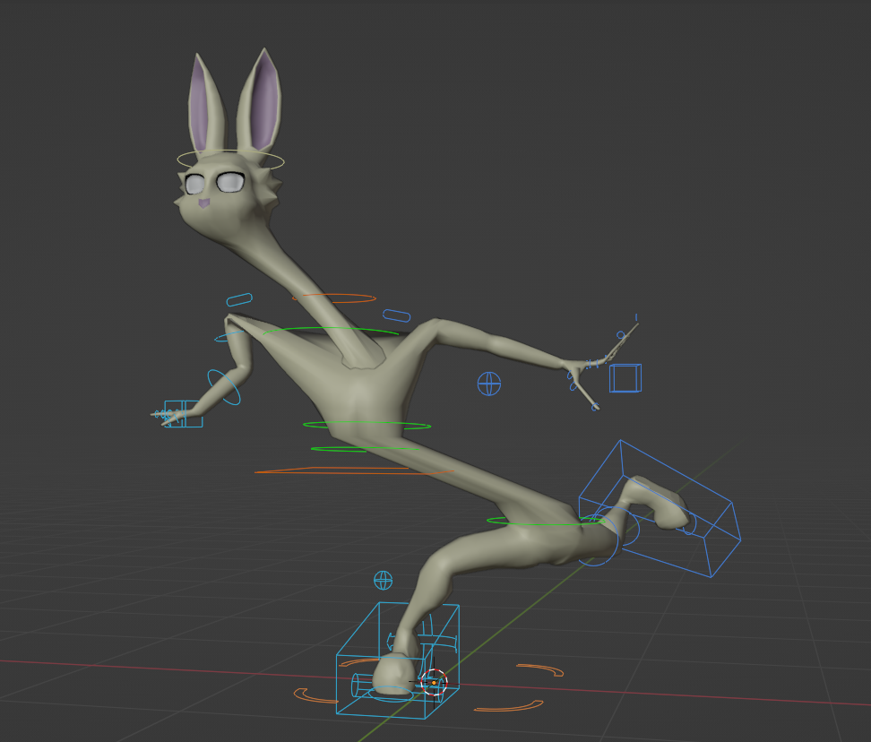
The Rabbit Village, Character Animations, and more!
Did concept art for UI
Worked on the Rabbit house models for an entire semester
Made animations for the rabbits and rocks.
Made a “photo booth” for the inventory sprites.
Ava Fritts

Slide 18


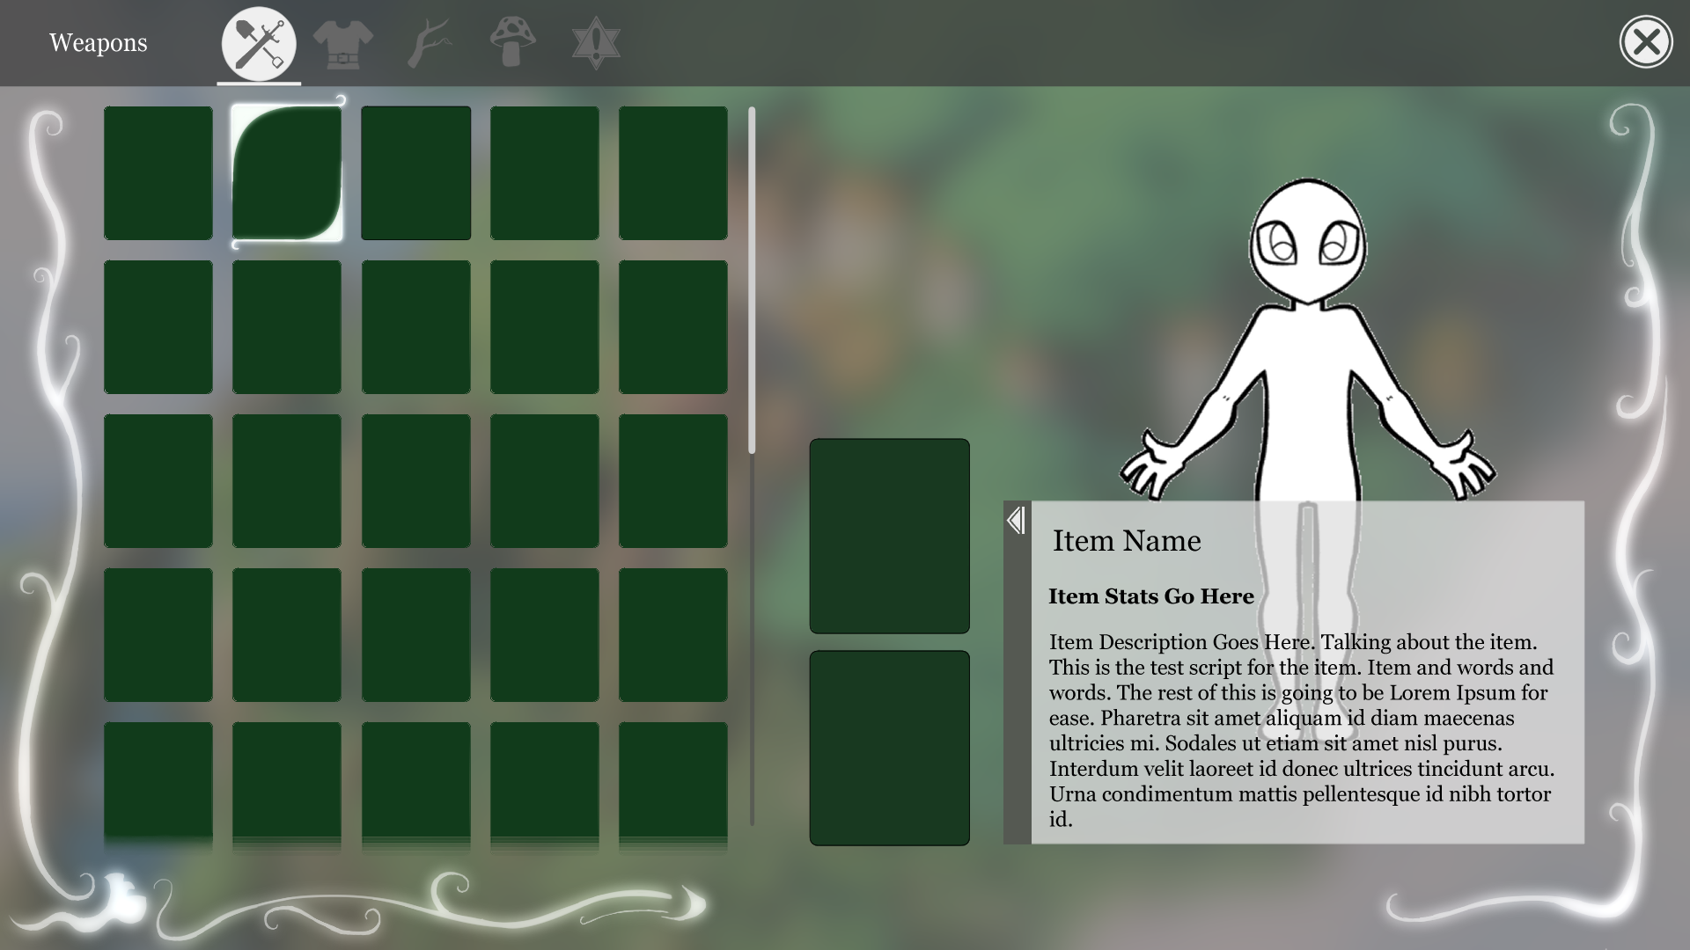
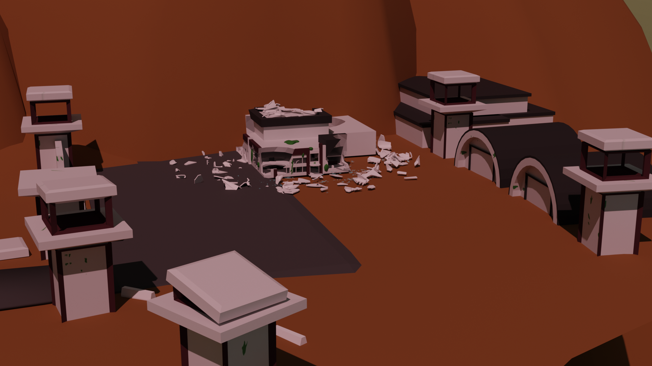

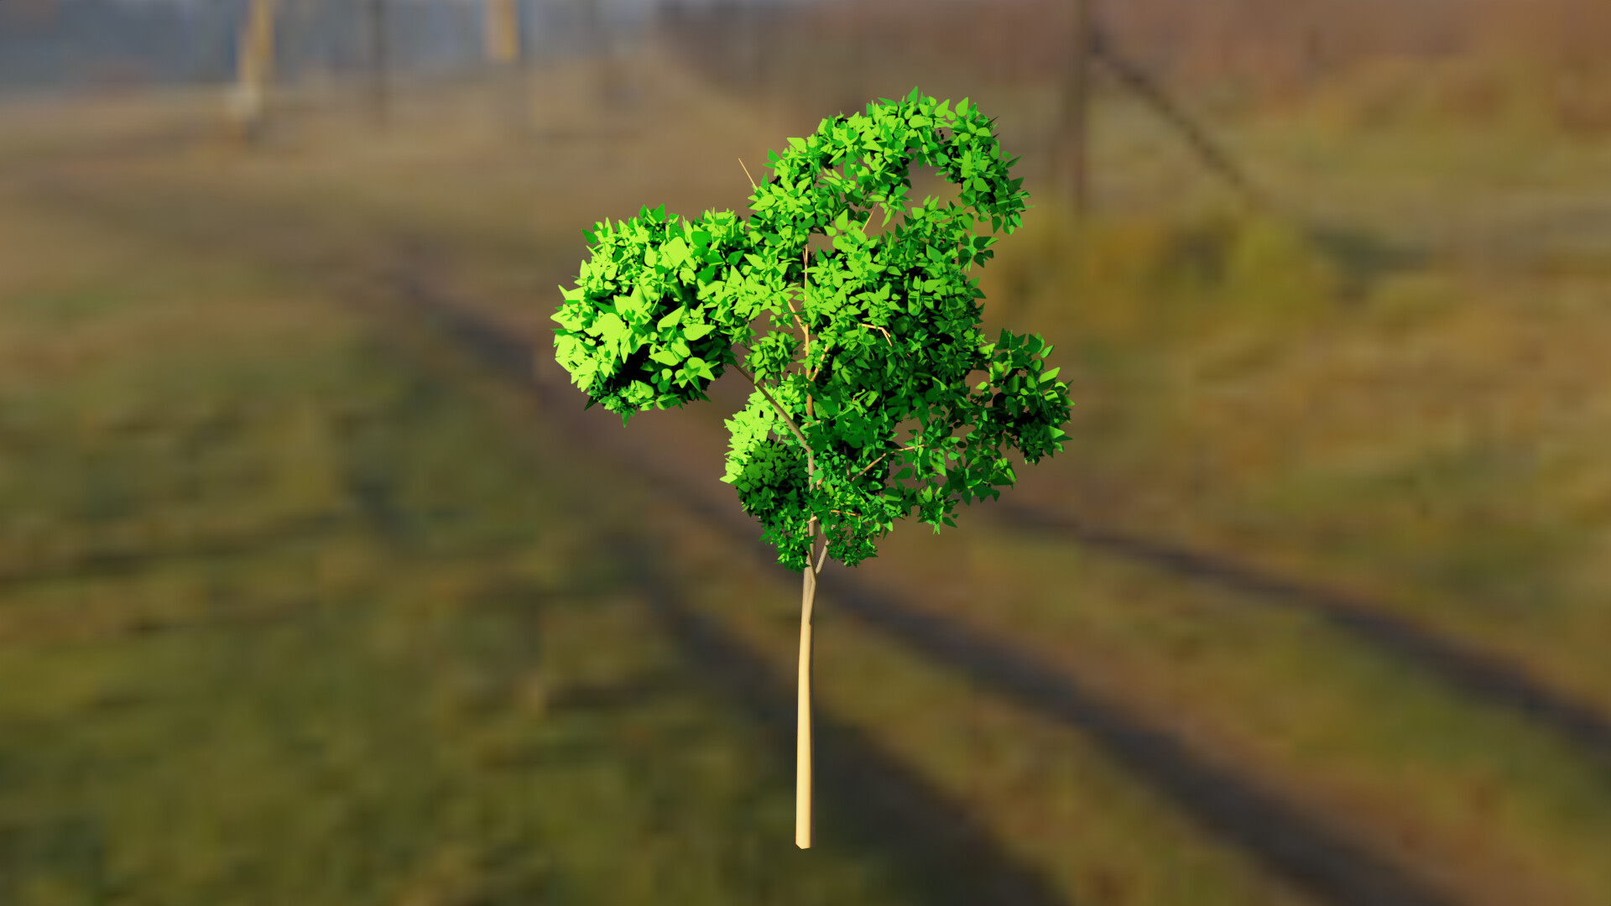
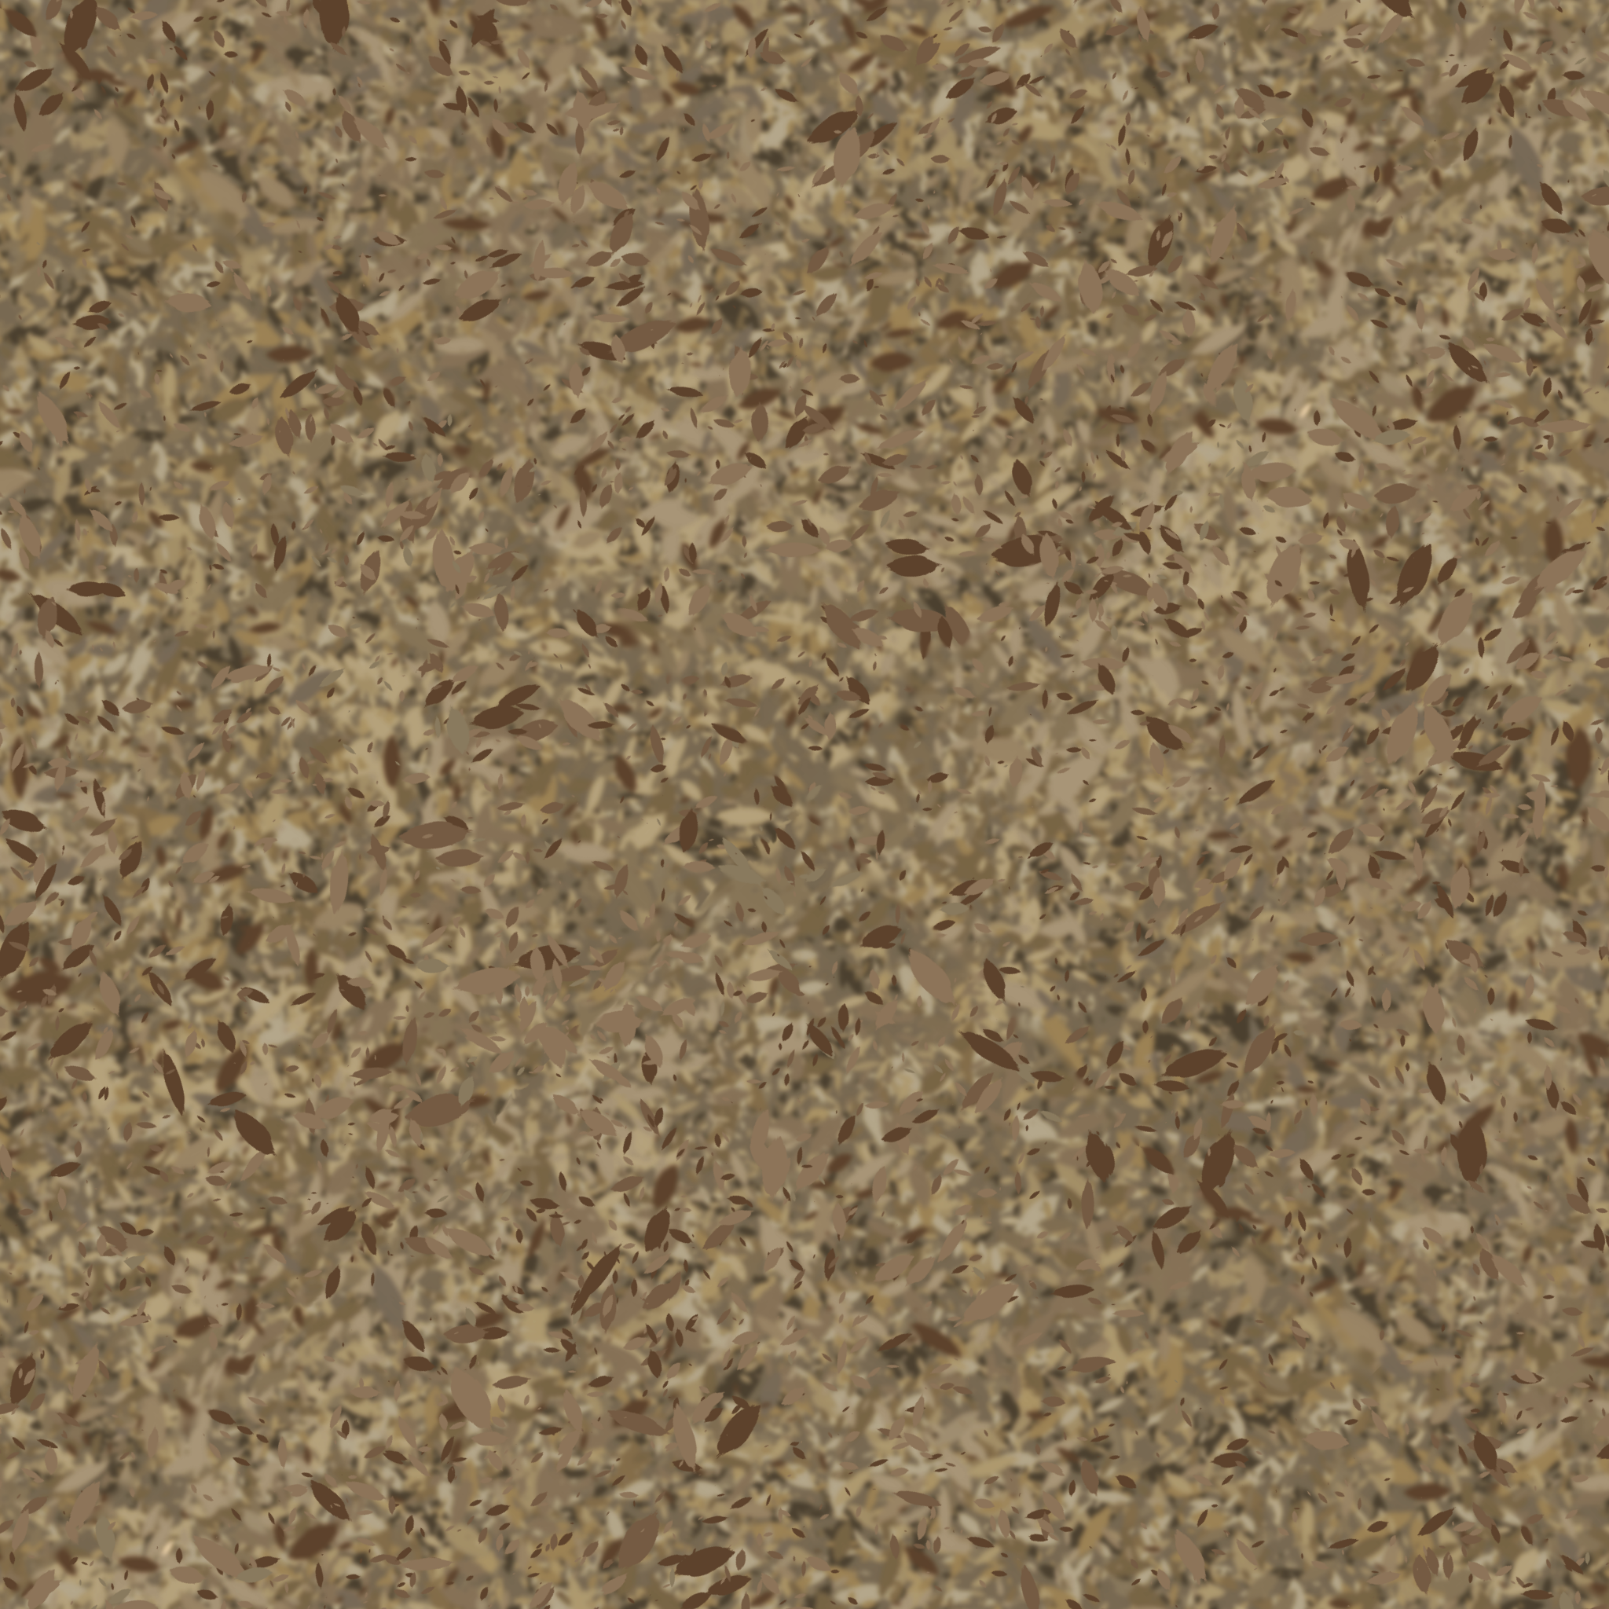

UI, Models, Terrain Textures
UI Design
Abandoned Lab
& Tree Models
Seamless Terrain Textures
Andrew Mires

Slide 19

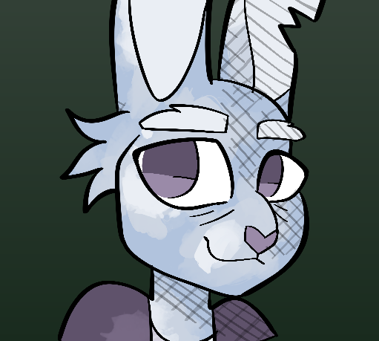
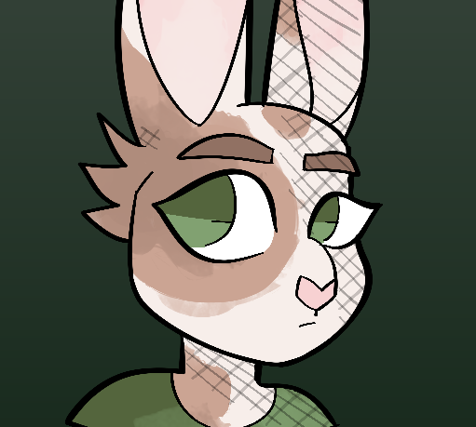
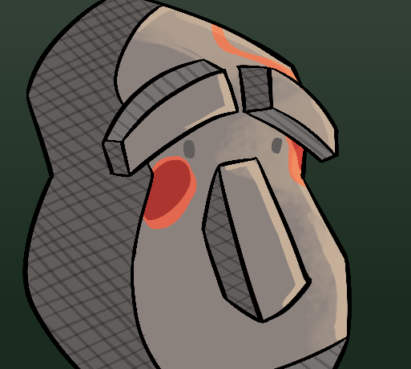
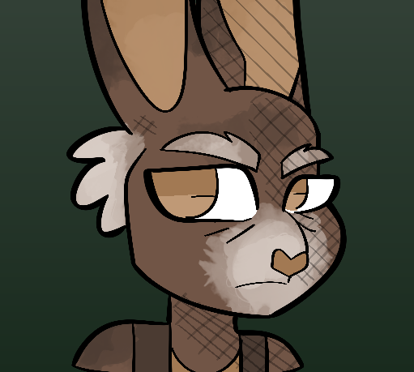
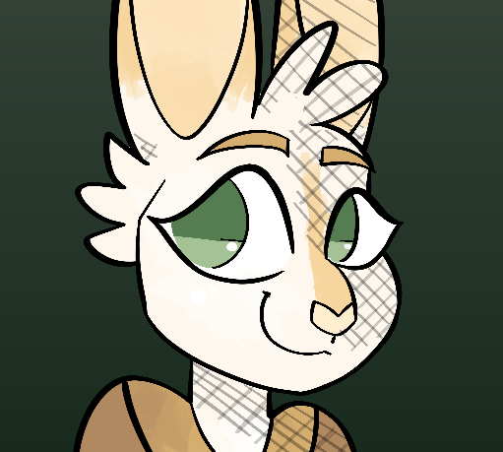
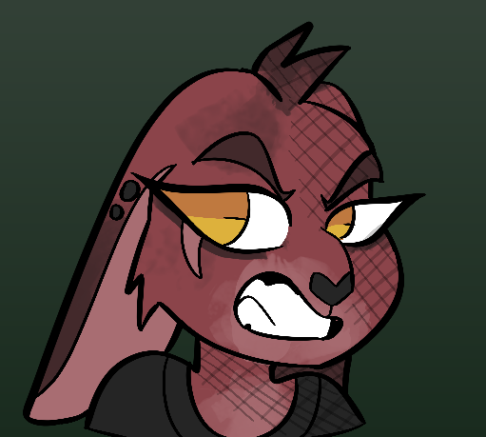
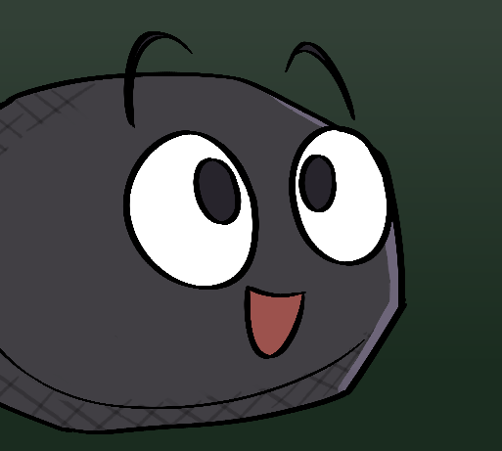





Custom Dialogue Icons!
Haley Kelly

Slide 20










Shader, Procedural Trees, Models, Goat
Zoe Delap

Slide 21




More Models
Most of my work was on the narrative
Models
William Gulick

Slide 22













Modeling, UVs, Texturing, Animation, and Continuity
Bridget Kurr
Notes:
1 8k Texture
1 Material in Unity
Flexibility in each model’s texture size
Greatly decreased batching means faster rendering speeds and no more dead laptops

Slide 23
Audio Team
Hear Hear!

Slide 24
Audio Overview
Part of interdisciplinary collaboration between CSG, Music, and Film School
Composing a dynamic music environment
Ambient soundscape
Player Interaction
NPC SFX and Voices
Composing -> Programming
Professor Joshua Lowery

Slide 25

Updates and Additions
Composed the music for the opening and Oracle cutscene
Updated out-of-date music colliders to match new positions
Updated music region transitions
Updated item throw, item drop, item pickup sounds
Added volume, sound effect, music volume controls
Added opening cutscene music to Oracle cutscene
Added battle music logic to enemies
New item equip and game loading sounds
Haiying Zeng

Slide 26
Footsteps
Created footstep and landing SFX for different materials (grass, rock, sand, etc.)
Added Wwise call for random container to randomize each SFX
Added state group for terrain toggle to switch between “Terrain”, “Wood”, and “Water” depending on where the player is
Added collider onto wooden bridge to call “Wood” state for wood footstep sfx
Added the animation event to the prefabs for the player armature
Created script for rabbit NPC footsteps and added to all their prefabs
Added 3d spatialized footsteps for rabbit NPC in Wwise depending on player’s orientation
Composed the Music for the Rock Village
Annette Lau

Slide 27
NPC Dialogue
Composed the music for the rabbit village
Fixed inventory sounds and Wwise containers for UI sounds
Added sound effects to menu and map open
Recorded and age/audio mixed new rabbit/rock voices and emotions
Added Age, NPCtype, and emotion state group in Wwise
Added Age, NPCtype, and emotion switch group in Wwise
Added NPC voice prefabs using Wwise and programming team’s scripts
Added NPC voices for opening encounters and apple quest
Blaine Grimes

Slide 28
Development Team
Bugs, bugs, and more bugs

Slide 29
Development Overview
Fighting feature creep
Adapting 3rd party assets
Initial chaotic merge standards
Solidified goals
Protected main & required Pull Requests
Panic sessions
Interconnected features
Brennan Crowder

Slide 30





UI, Player, & Quest Features
Map Window
Outlines and PlayerApproach
Movement/Input Refactor
Abilities
Mana
Jump
Stoneskin
Ram
Quest scripts
EnemyCounter
ItemManager
Etc
Save System
Jacob Sharp

Slide 31




Inventory and Bug Fixes
Custom item system
Tagging
Multiple use actions
Inventory
Item stacking
Hand slots
Two handed items
Interactables
Items, NPC’s, etc.
Bug Fixes from playtest notes
Coleton Wheeler

Slide 32

Enemy AI
Enemy AI can detect when the player enters their sightline
Enemy AI has three states: Idle, Follow, and Attack.
A zone can be designated where the enemies will not follow the player outside.
Jeremiah Underwood

Slide 33
Tutorial Area and Quest Implementations
Implemented Tutorial Area to teach
Movement
Quest Menu
Item Mechanics
Added feathered friends to game
Small bug fixes
Zoe Delap

Slide 34


Quest & Dialogue Systems
Utilized existing assets with modifications
QuantumQuest and DialogueEditor
Interact with other game systems
Individual quest implementations
Benjamin Krieger

Slide 35



Dev tools & Dialogue Anims
Dev Menu
Cutscene Framework
Rabbit Emotions
Bug fixes
Brennan Crowder

Slide 36
Playtesting

